Slide 1
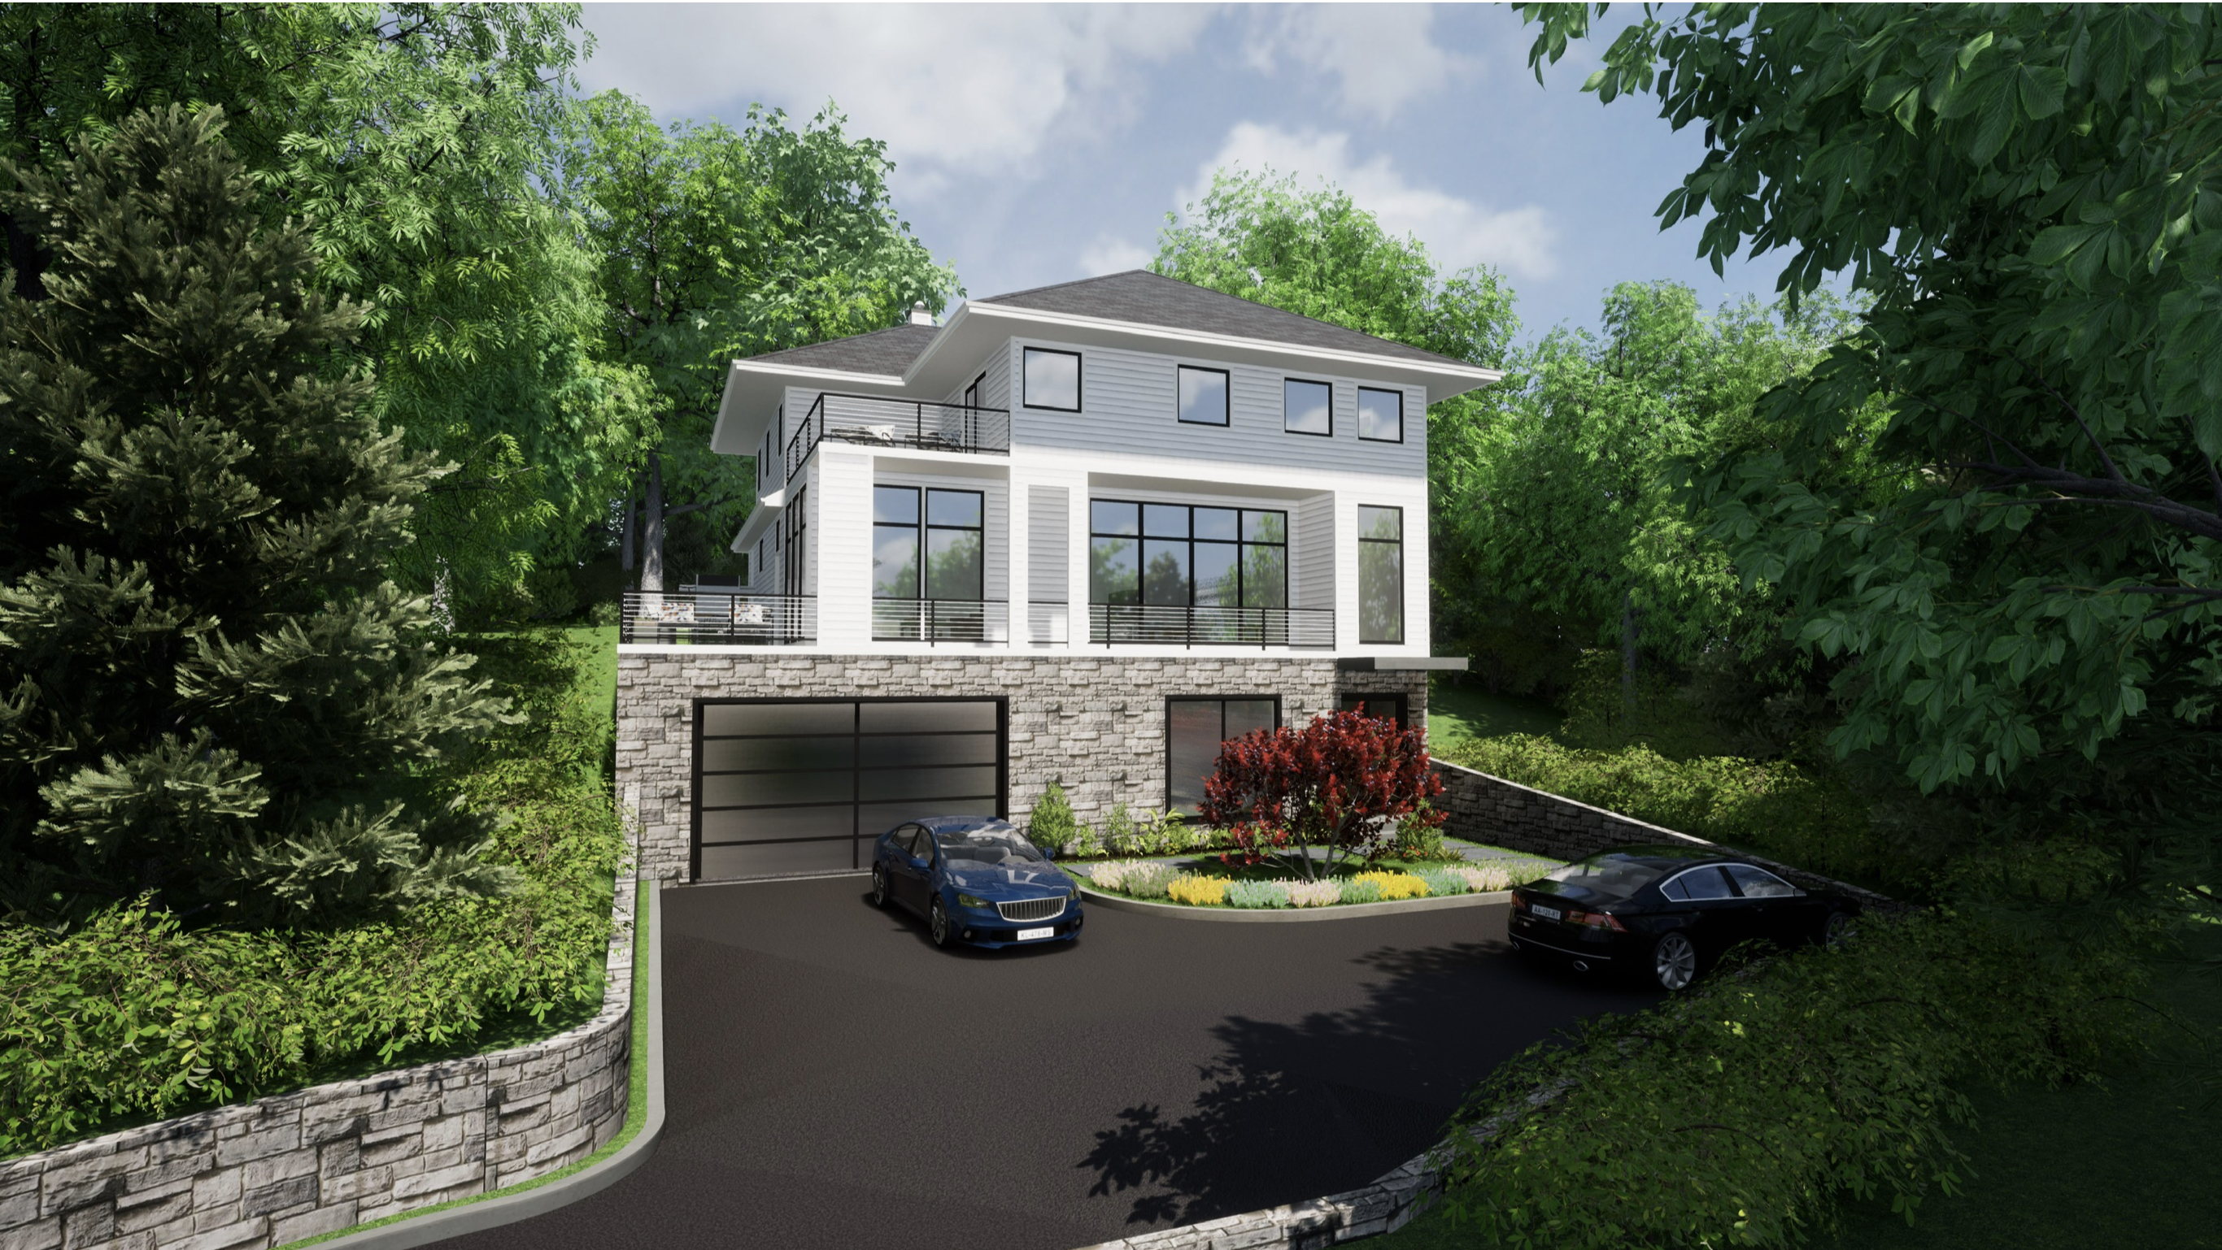
0 Lefurgy Ave.
Anand Single family Residence

Slide 2
Summary
Per the Pre-Submission hearing in April 2023, the following items were missing:
Stormwater Management Plan / Erosion and Sediment Control
Grading Plan
Ensure the house number is listed as 0 Lefurgy Ave./ Latest survey
Materials List - finishes and color
Lighting
Property in relation to neighboring properties
Sky Exposure Plane
Bald Eagles
Updated Site Plan
Trees and Landscaping

Slide 3
Stormwater Management Plan/ Erosion and Sediment Control

Slide 4
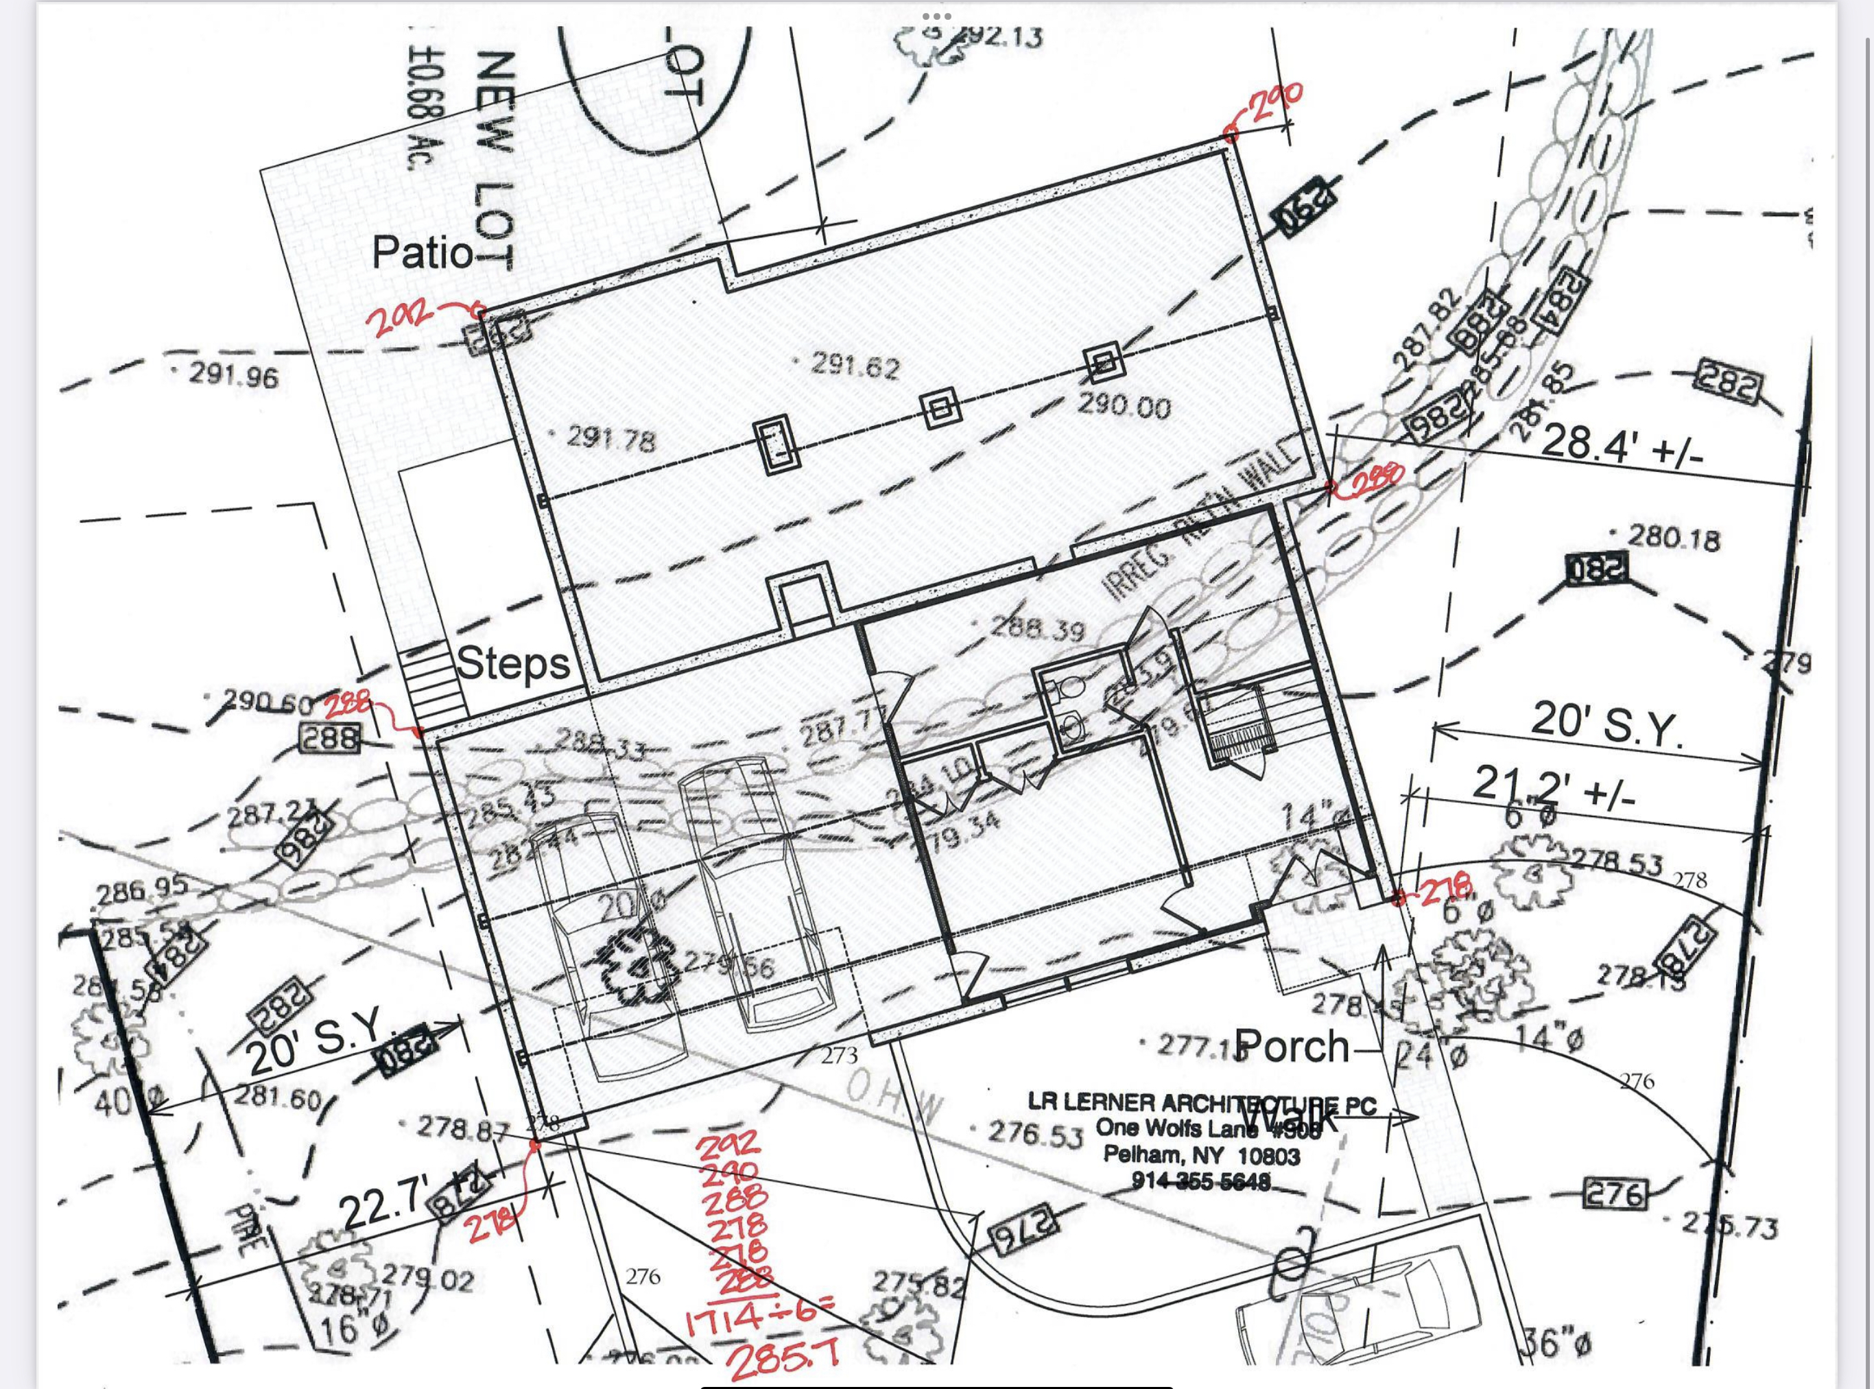
Grading

Slide 5
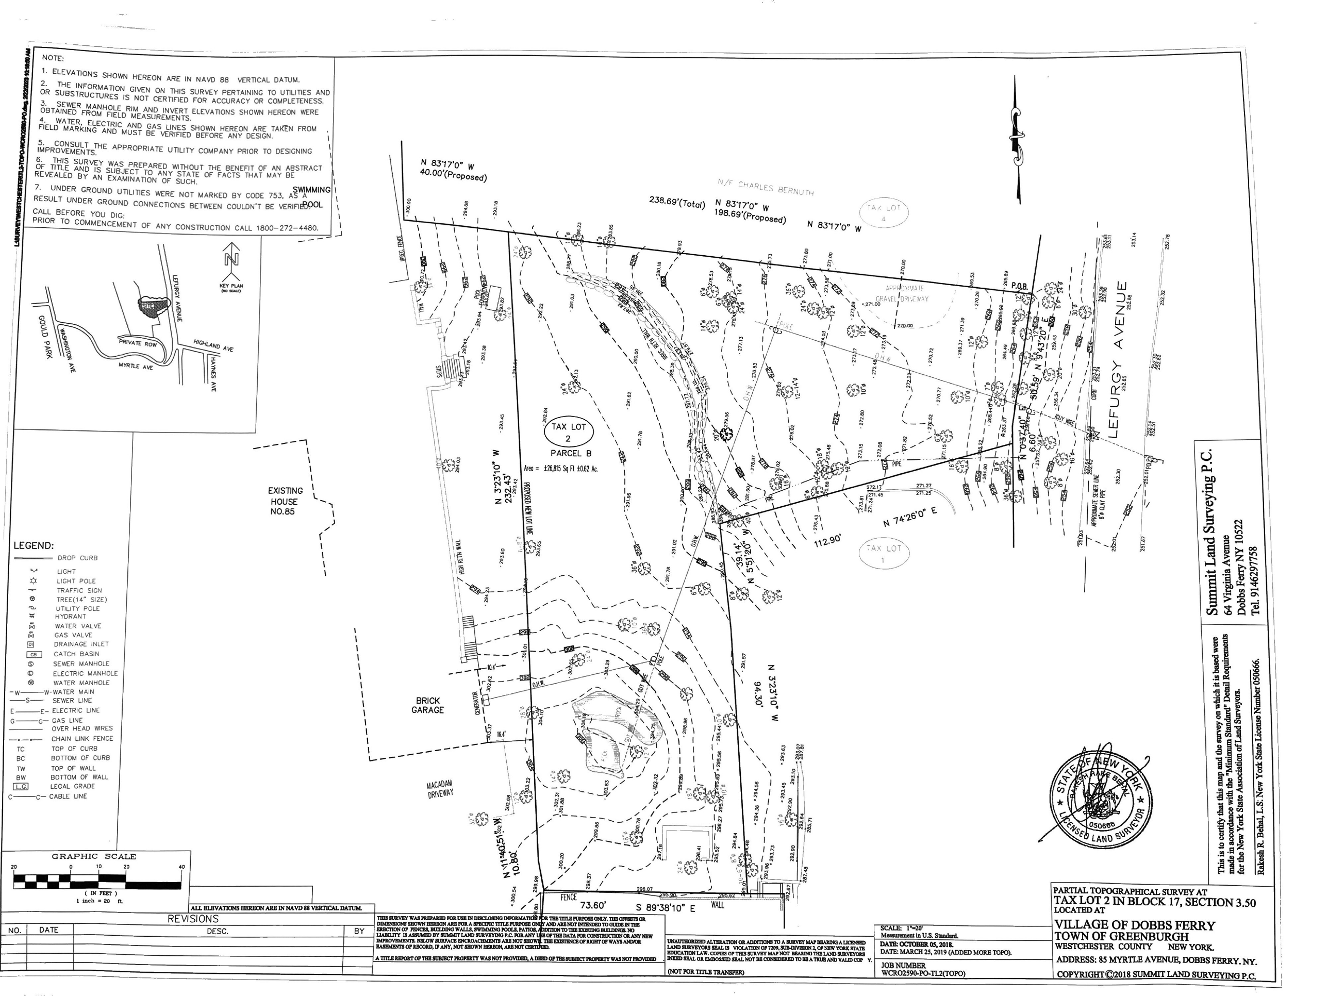
Latest Survey

Slide 6
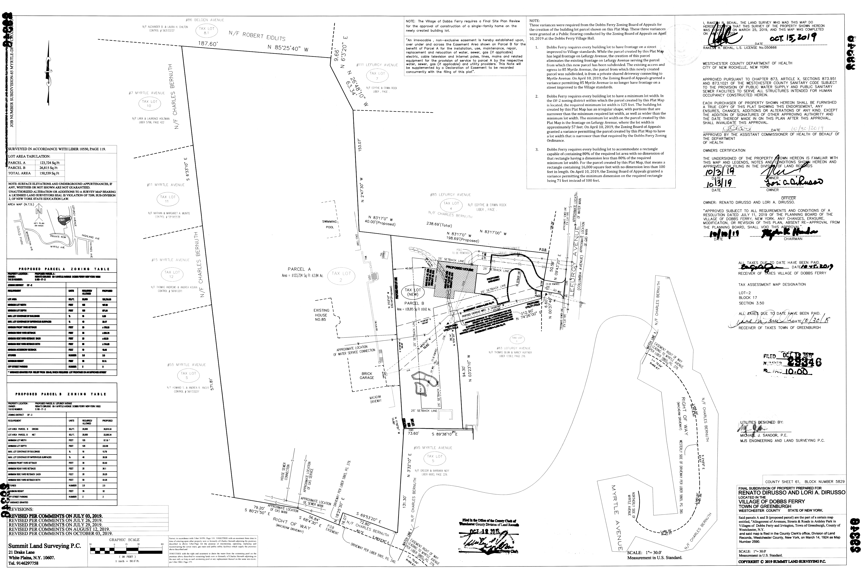
Latest Survey

Slide 7
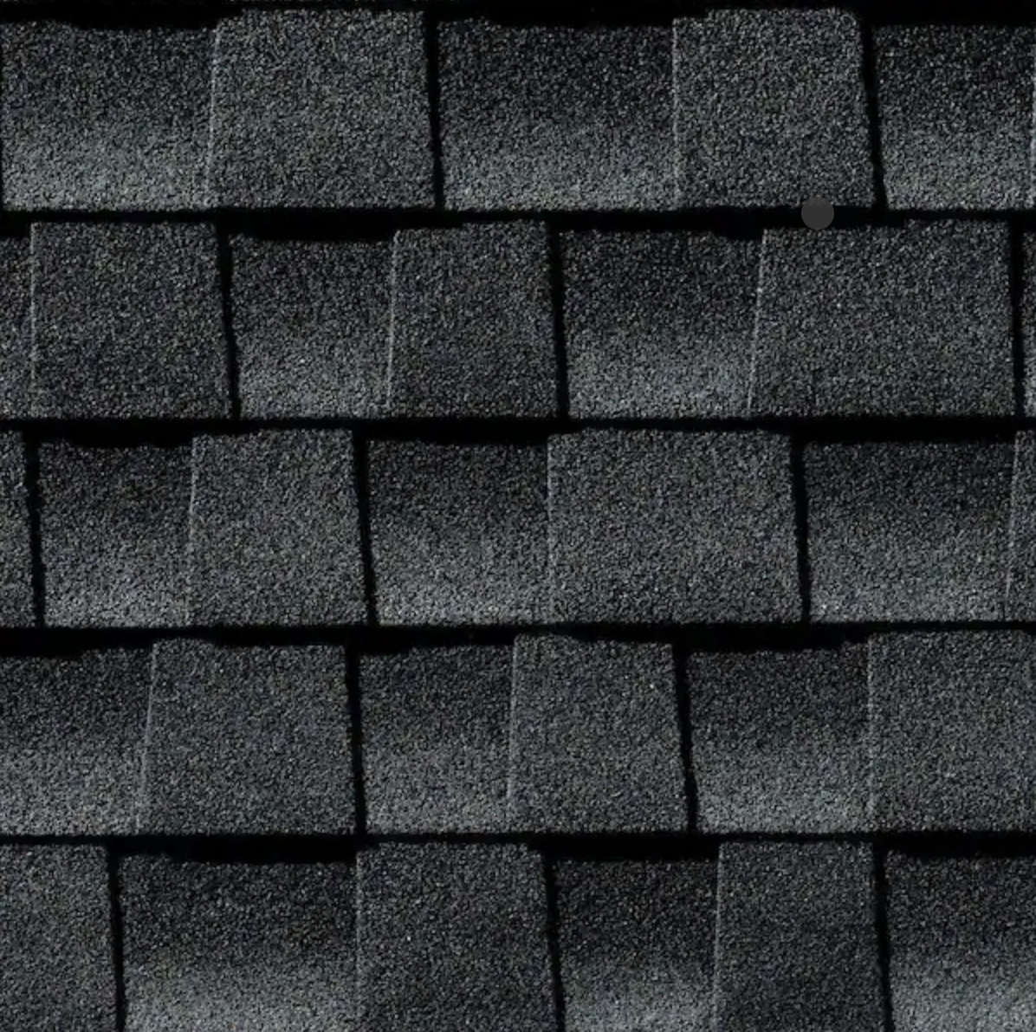
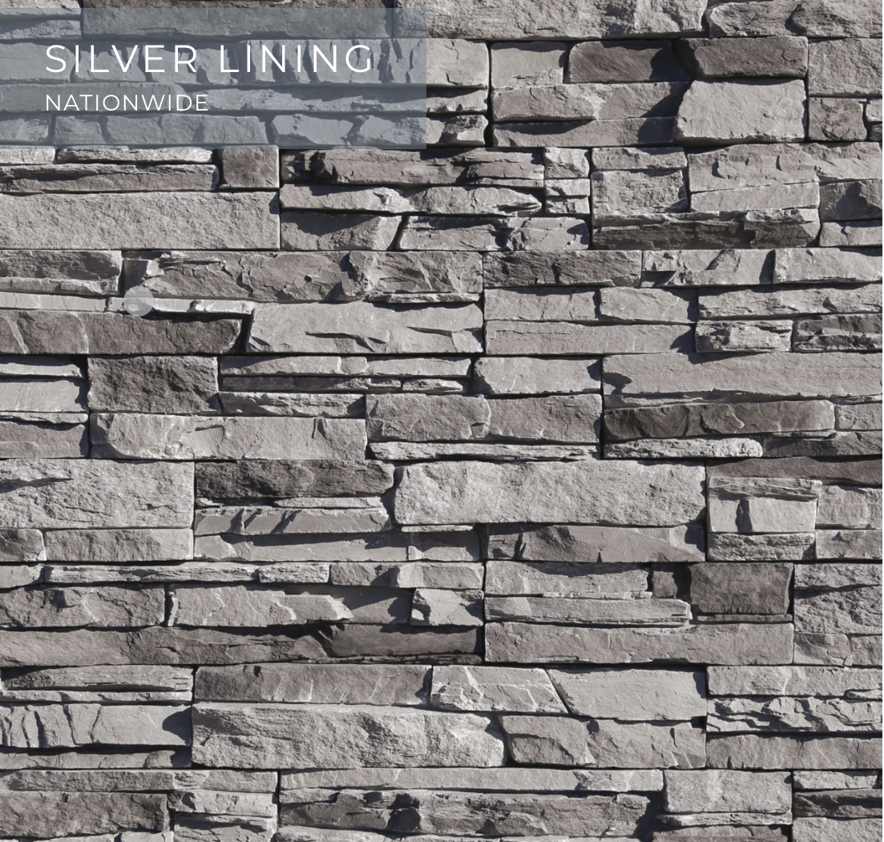
Materials
Roof - (Potentially Solar) GAF Charcoal Timberline
Windows - Anderson A Series Bronze
Ground Floor - Stone Veneer Elderado Stone Silver Lining
2nd & 3rd Floors - Hardie Plank Lap Siding Smooth Light Mist Urban Grey

Slide 8
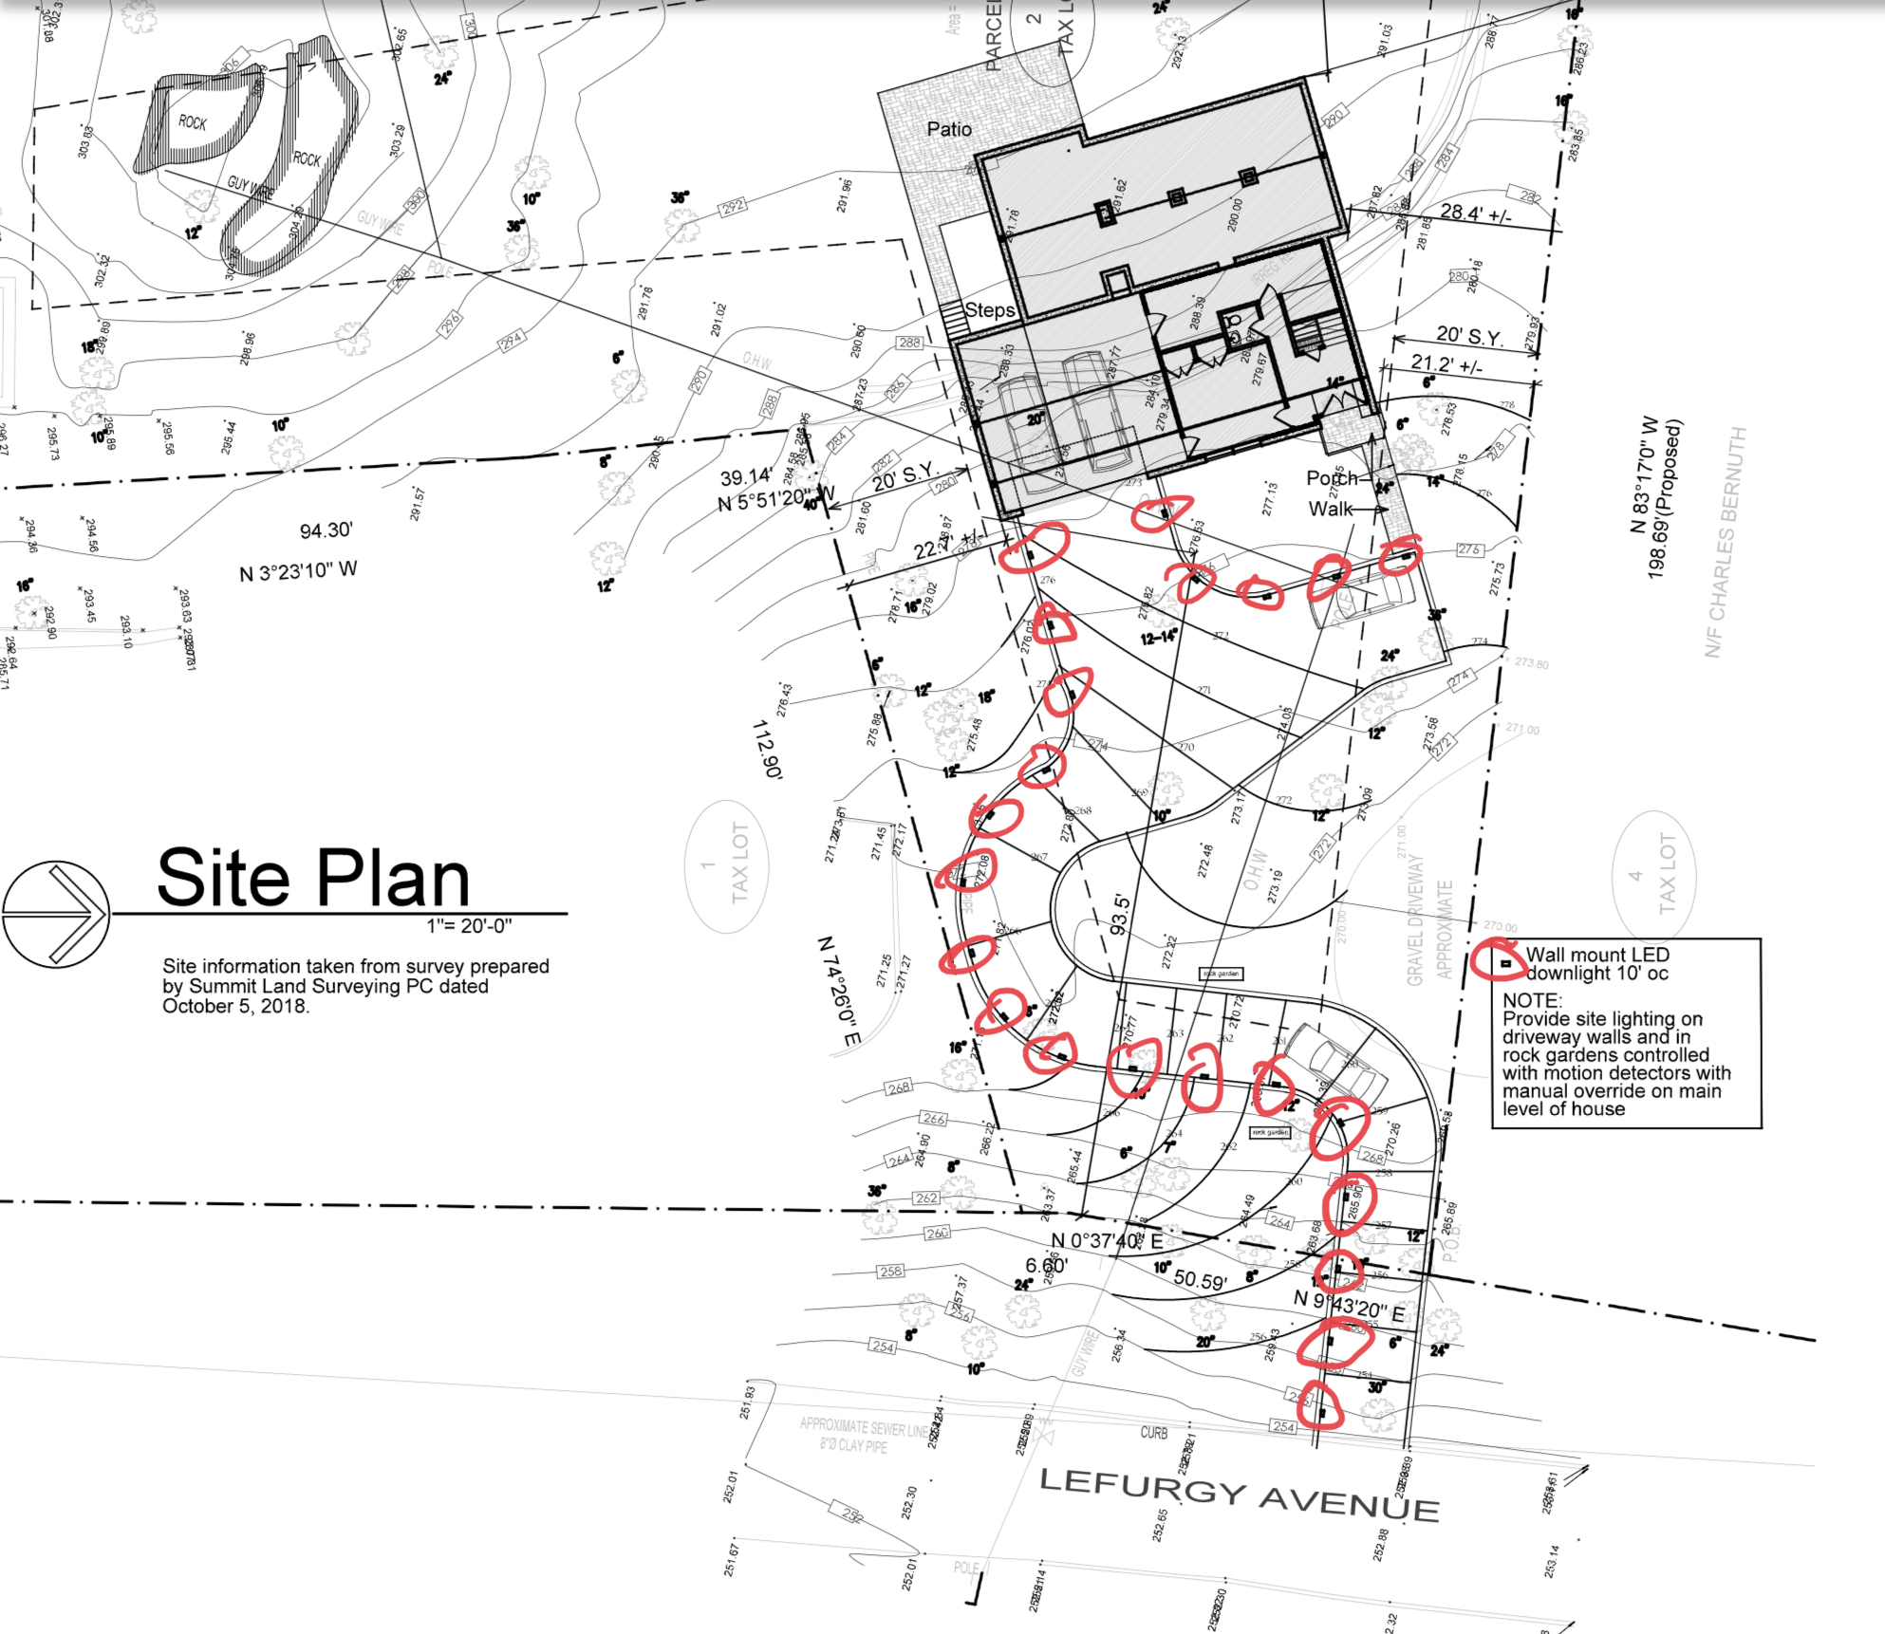
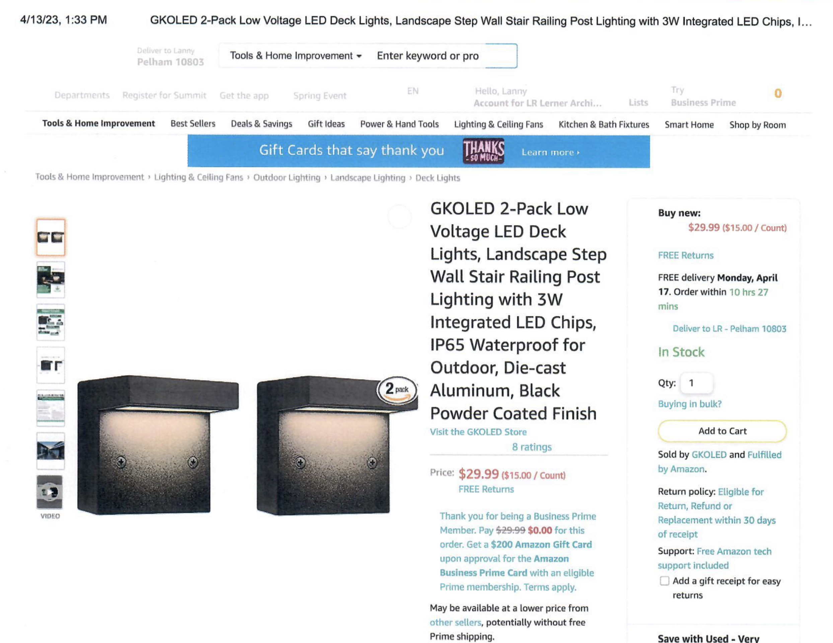
Lighting

Slide 9
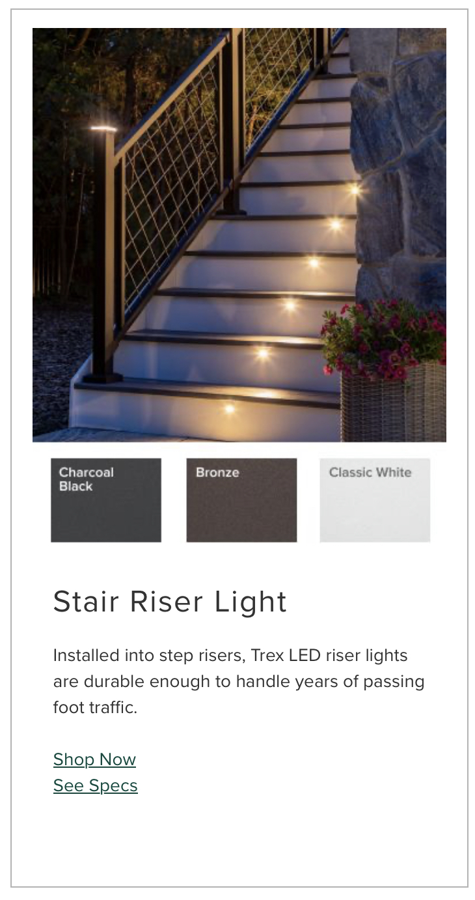
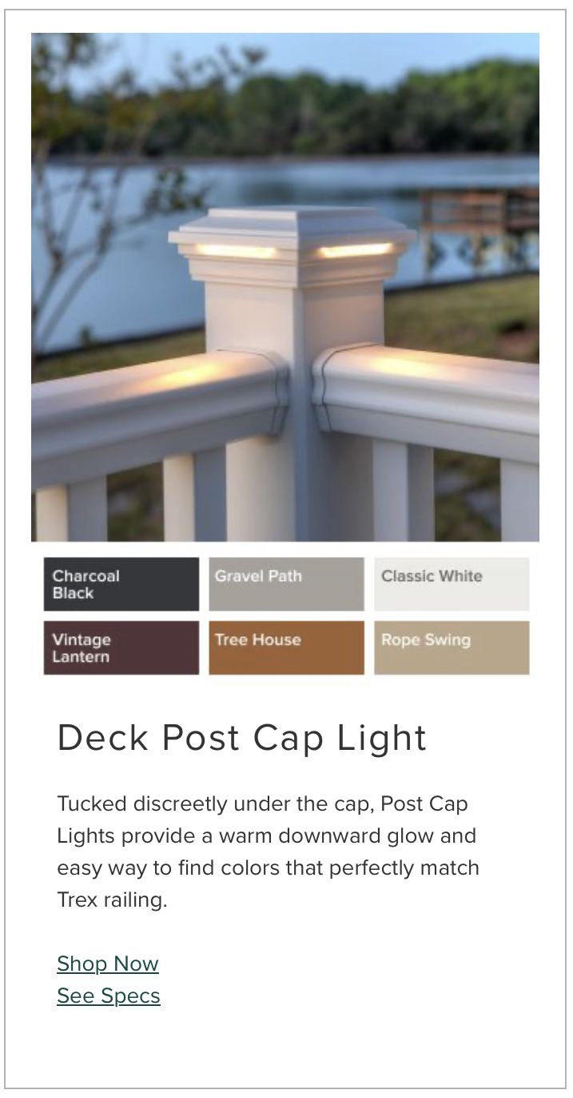
Lighting

Slide 10
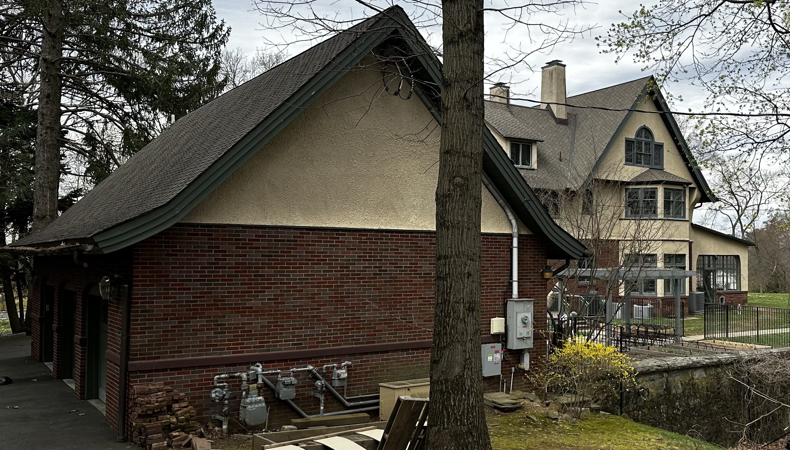
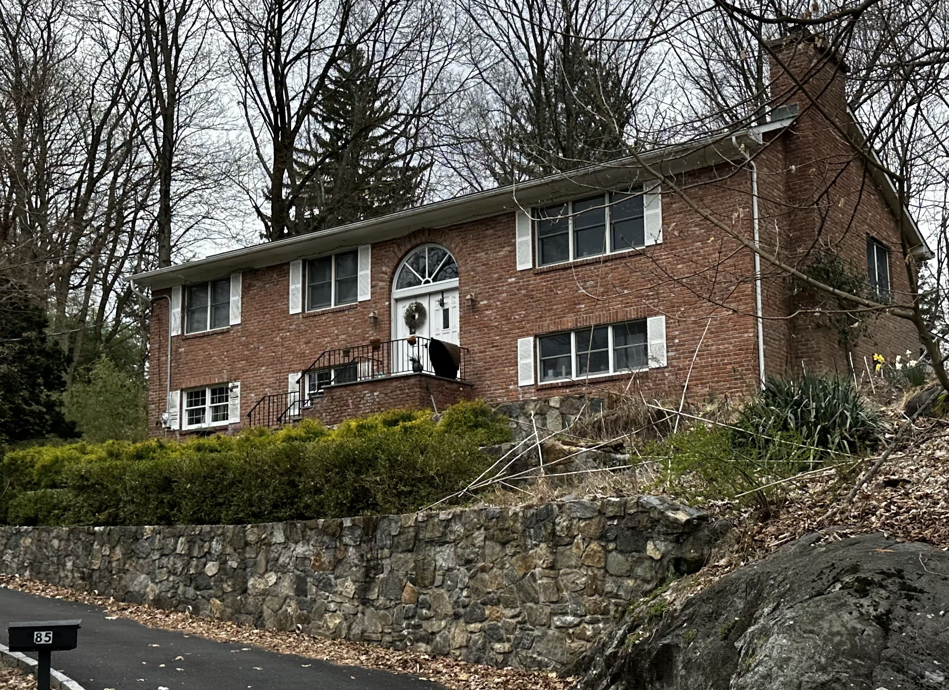
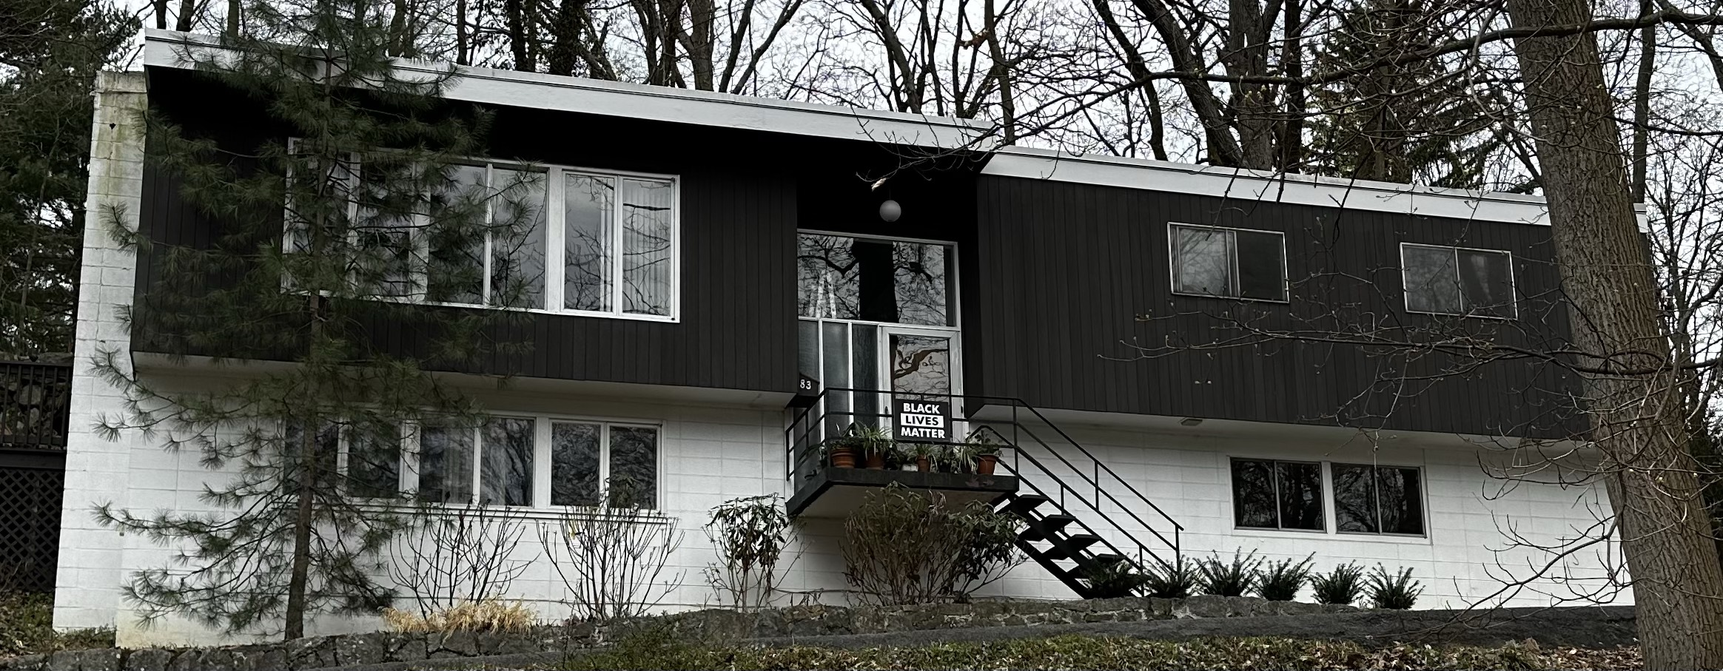
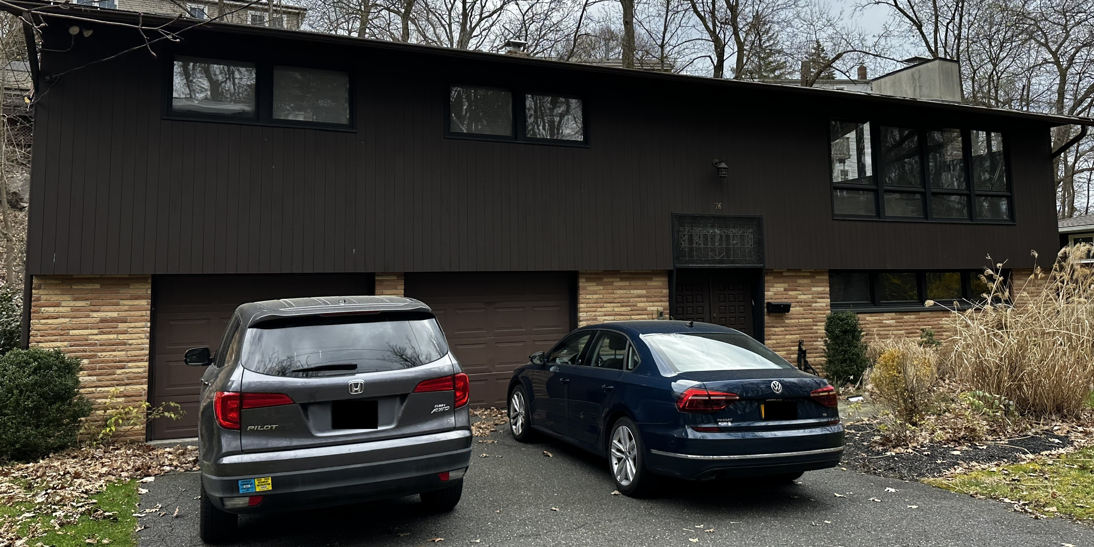
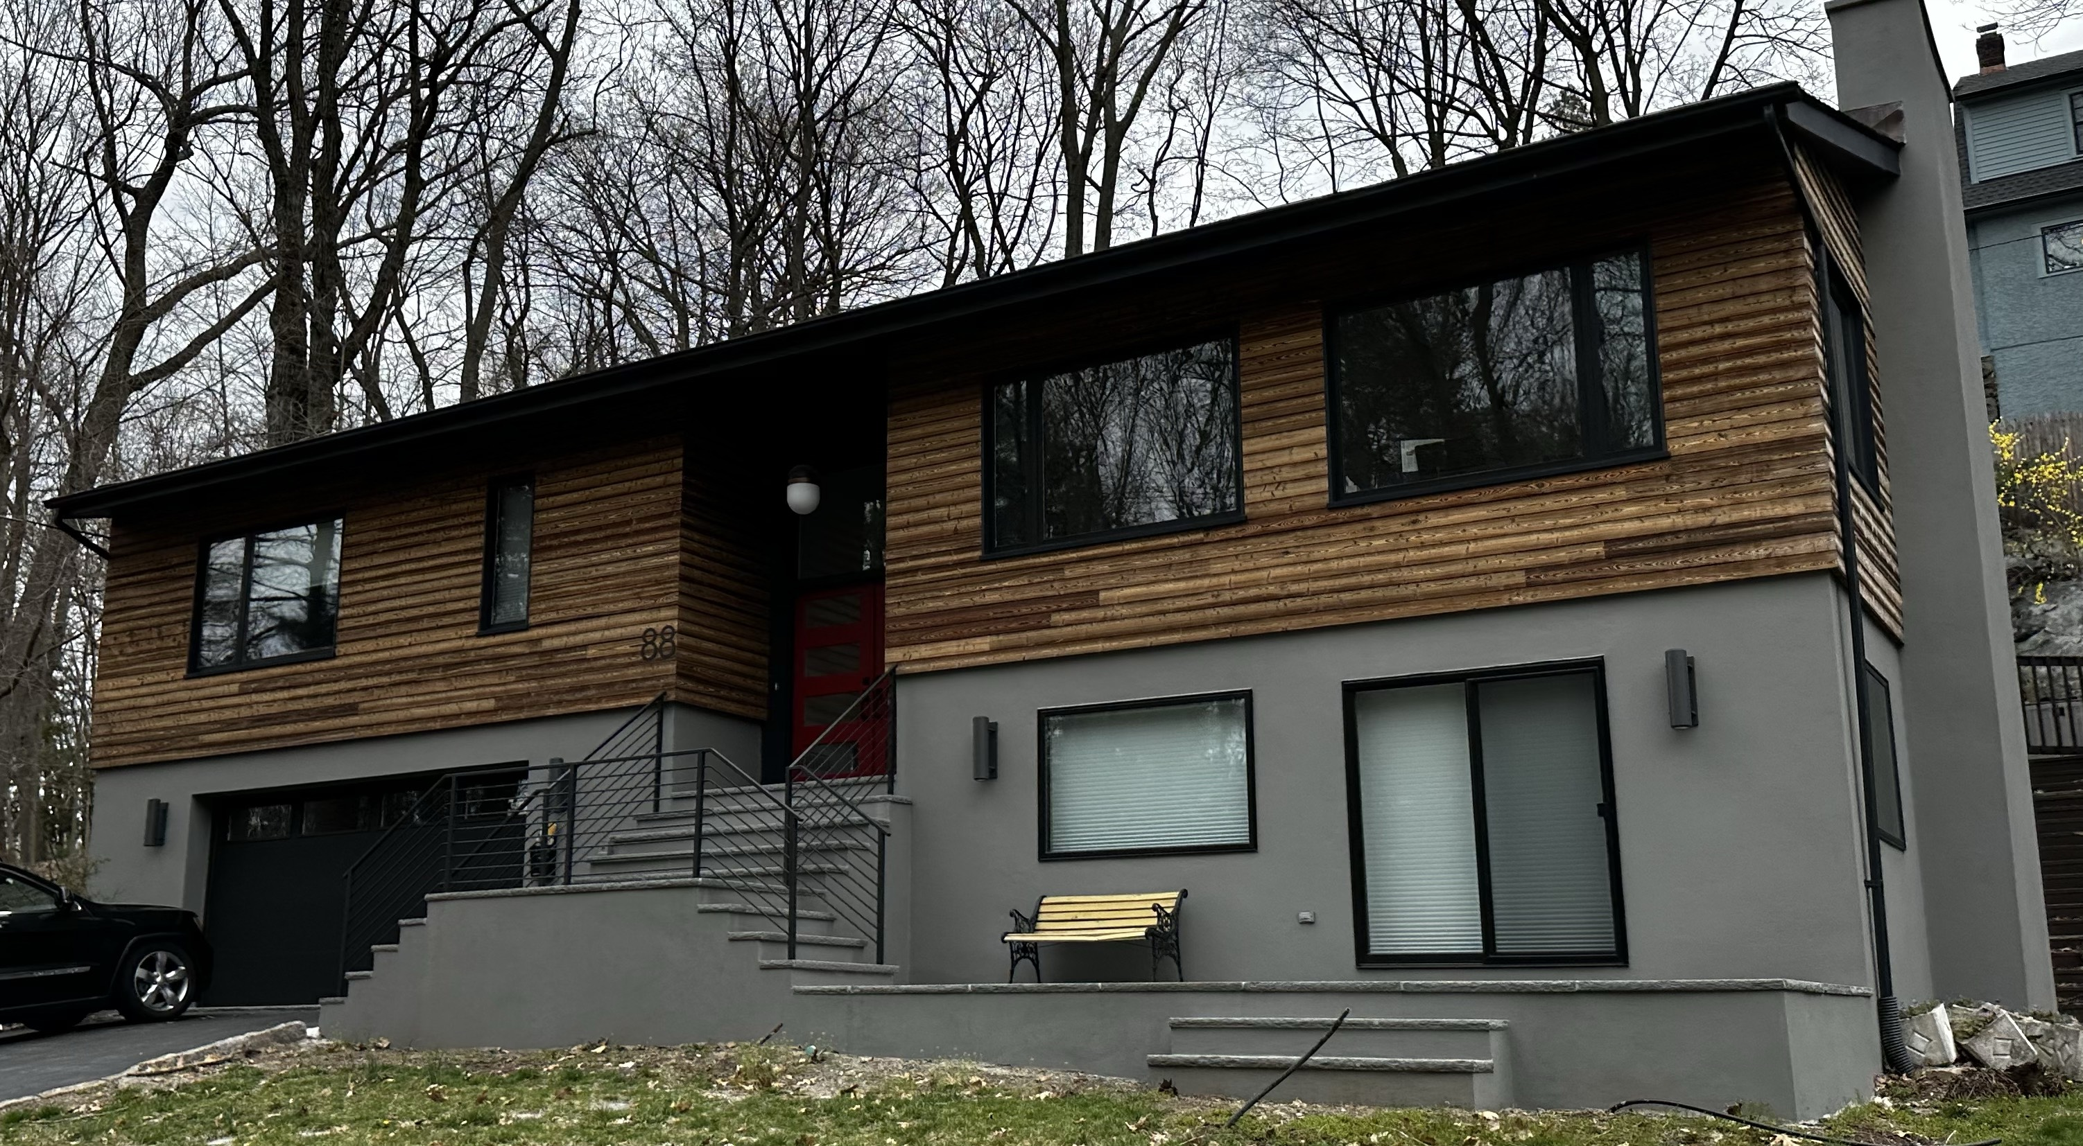
The Neighborhood

Slide 11
The Neighborhood

Slide 12
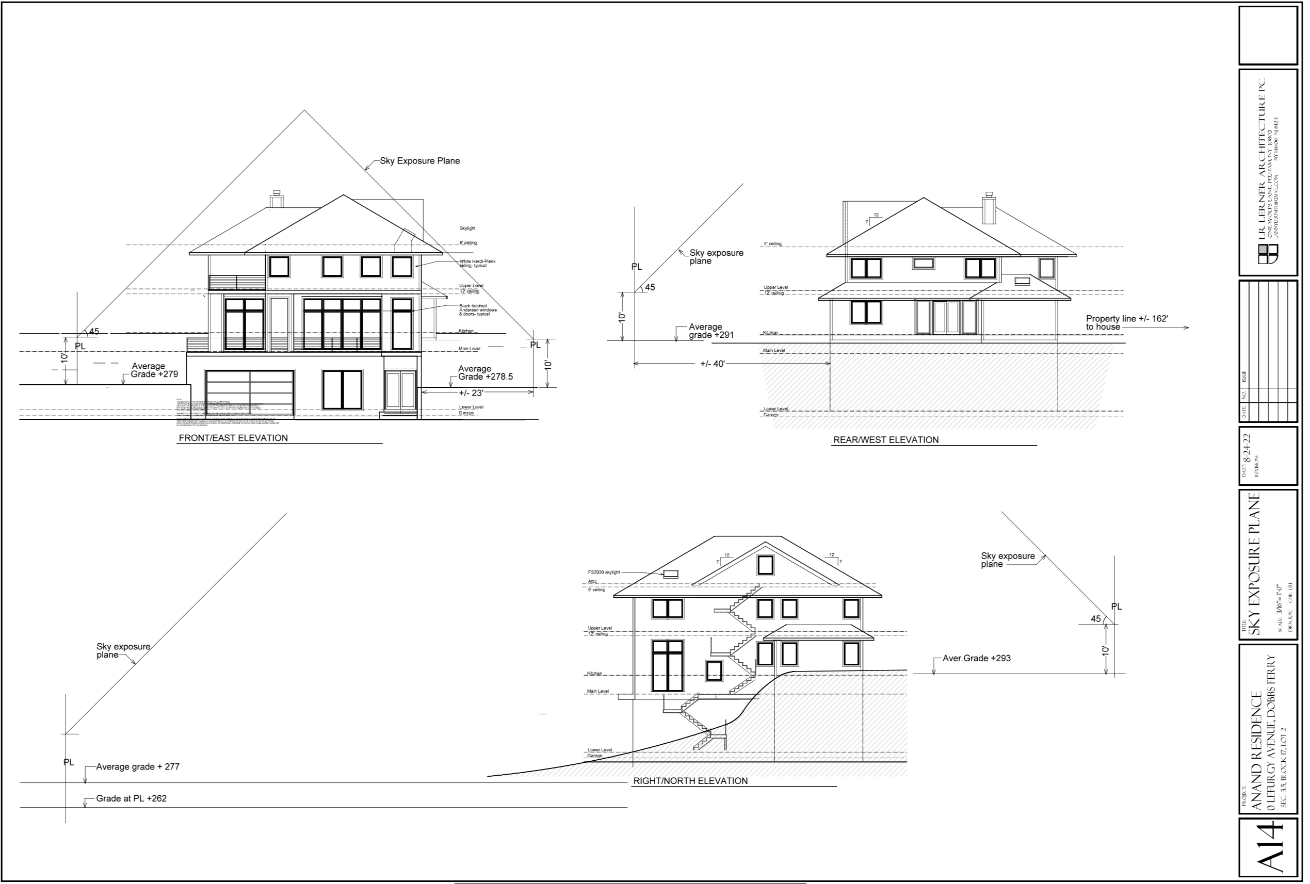
Sky Exposure Plane

Slide 13
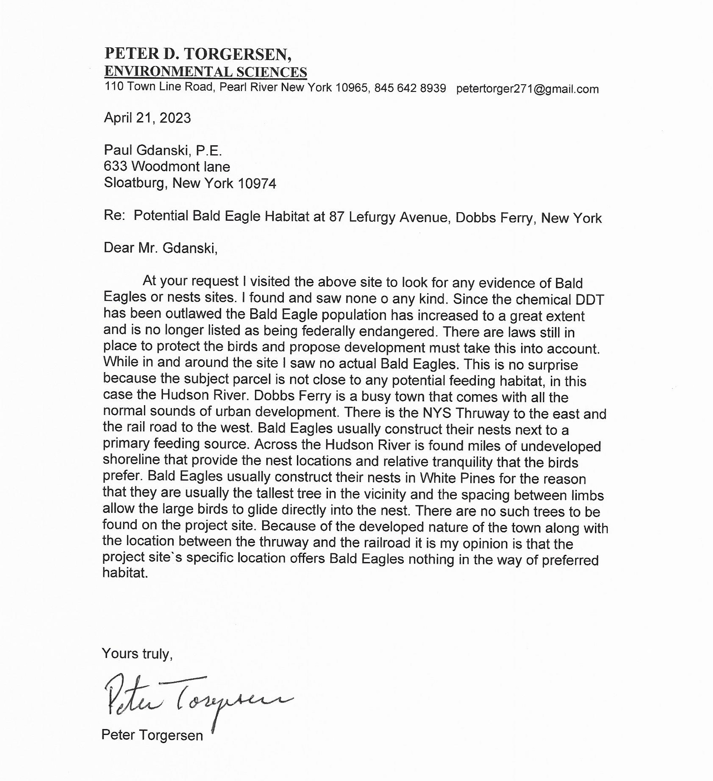
Bald Eagles

Slide 14
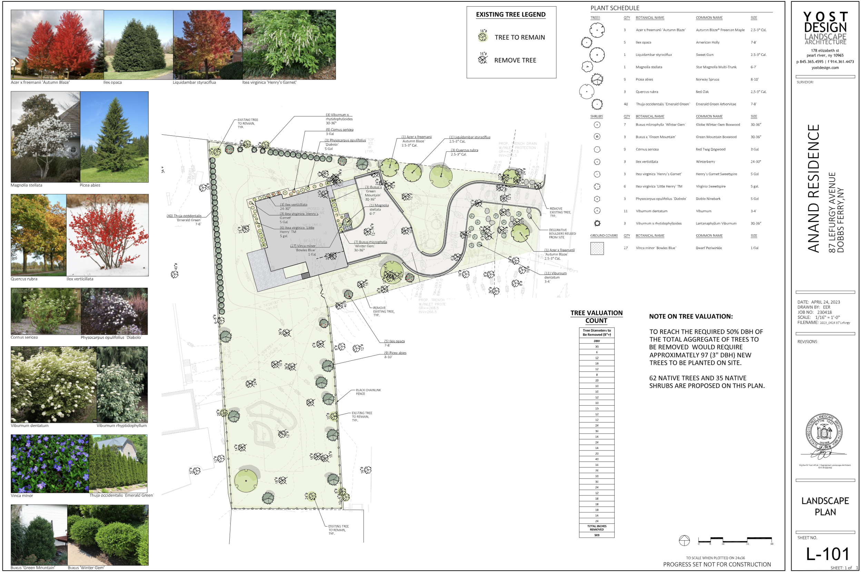
Trees and Landscaping

Slide 15
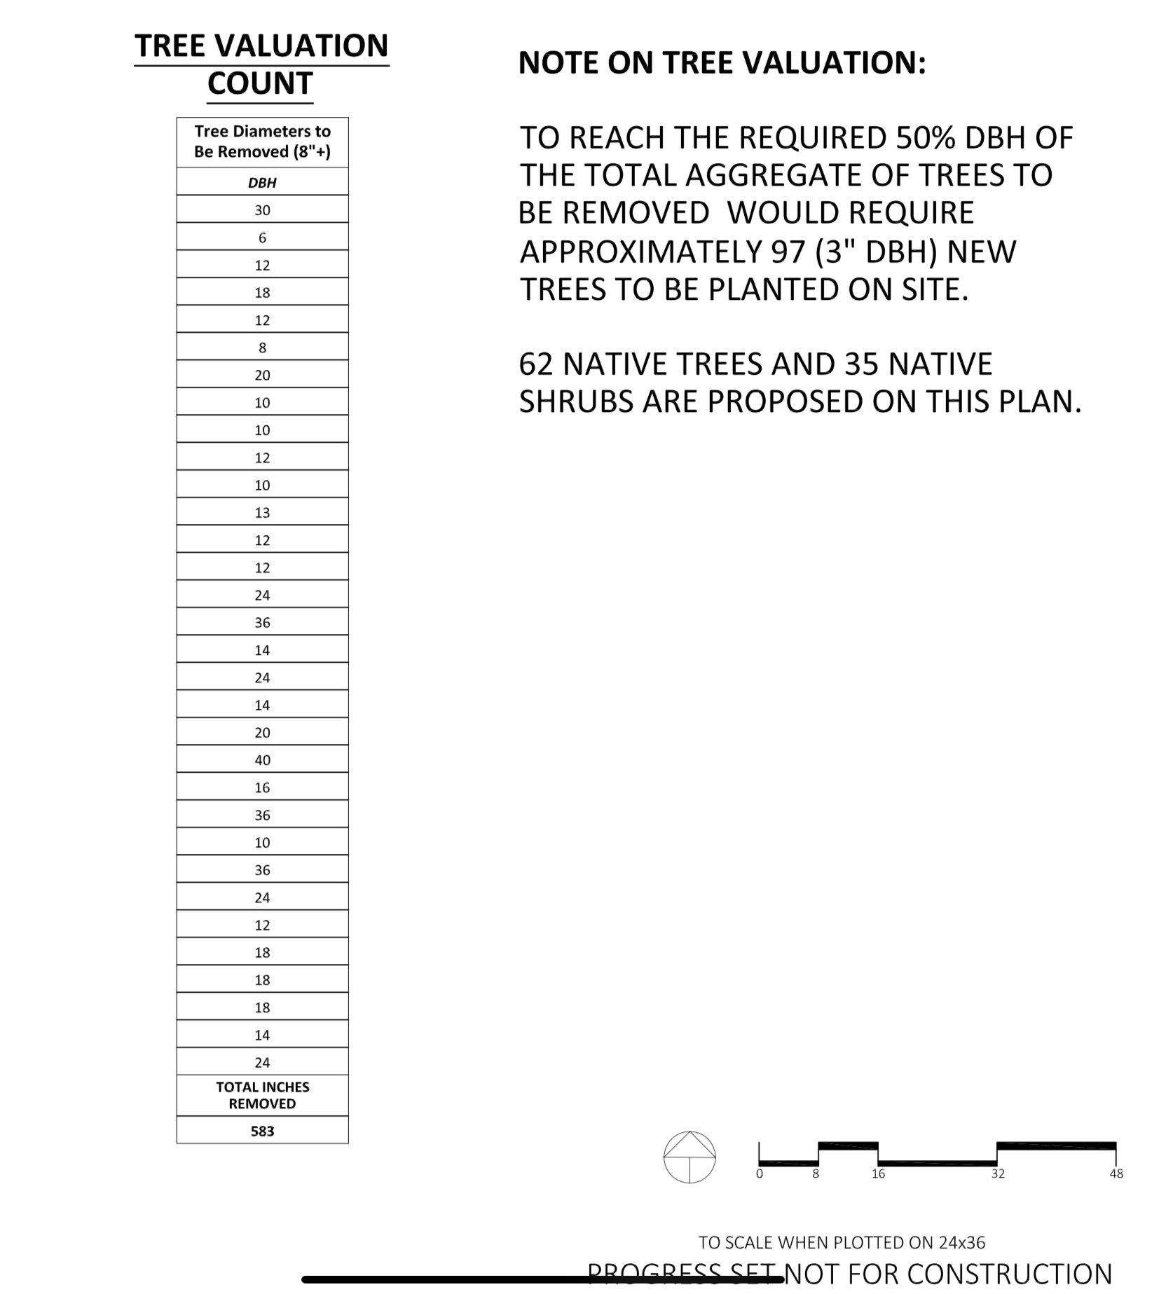
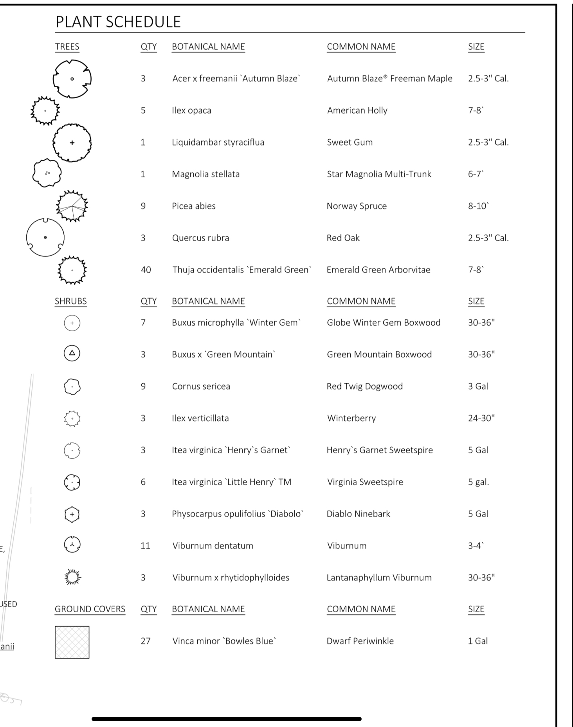
Trees and Landscaping

