Slide 1
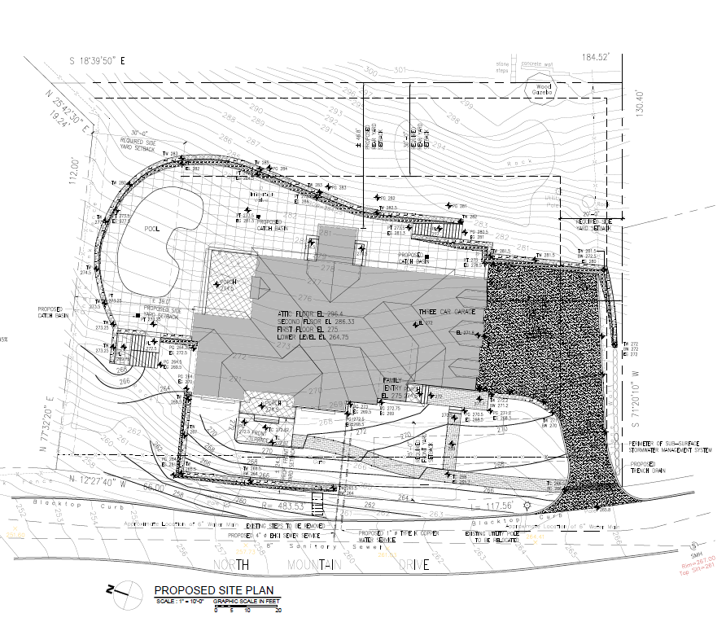
0 North Mountain Drive, Dobbs Ferry, New York

Slide 2
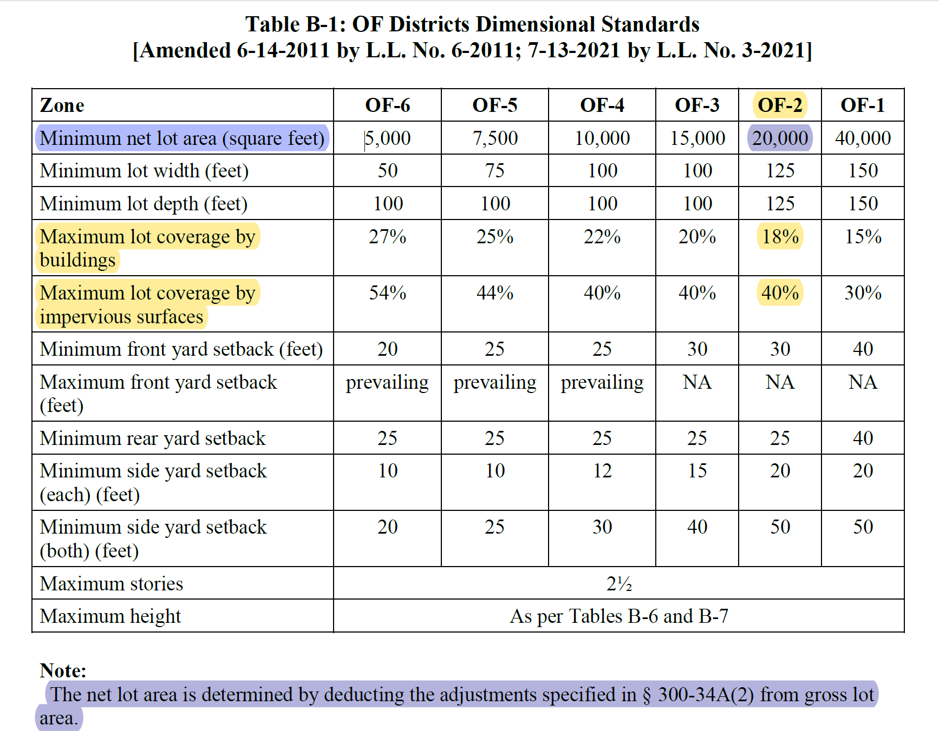
0 North Mountain Drive, Dobbs Ferry, New York
Attachment 2 to Chapter 300, Table B-1 sets forth the Dimensional Tables for One Family Districts
Chapter 300 of the Village of Dobbs Ferry Code details Zoning and Land Use

Slide 3
0 North Mountain Drive, Dobbs Ferry, New York
North Mountain Drive is in the OF-2 District
Table B-1 Sets forth the Dimensional Standards as highlighted herein
Minimum net lot area for OF-2 is set at 20,000 square feet and this issue is currently before the Zoning Board for a variance
Table B-1 sets forth additional requirements including Maximum lot coverage by buildings (18%) and Maximum lot coverage by impervious surfaces (40%)
Other than the minimum net lot area on the first row of the table, the net lot area is not used for any other calculations.
Section 300-34(A)(2) solely relates to steep slopes and applies to the Minimum net area
Chapter 300 of the Village of Dobbs Ferry Code details Zoning and Land Use

Slide 4
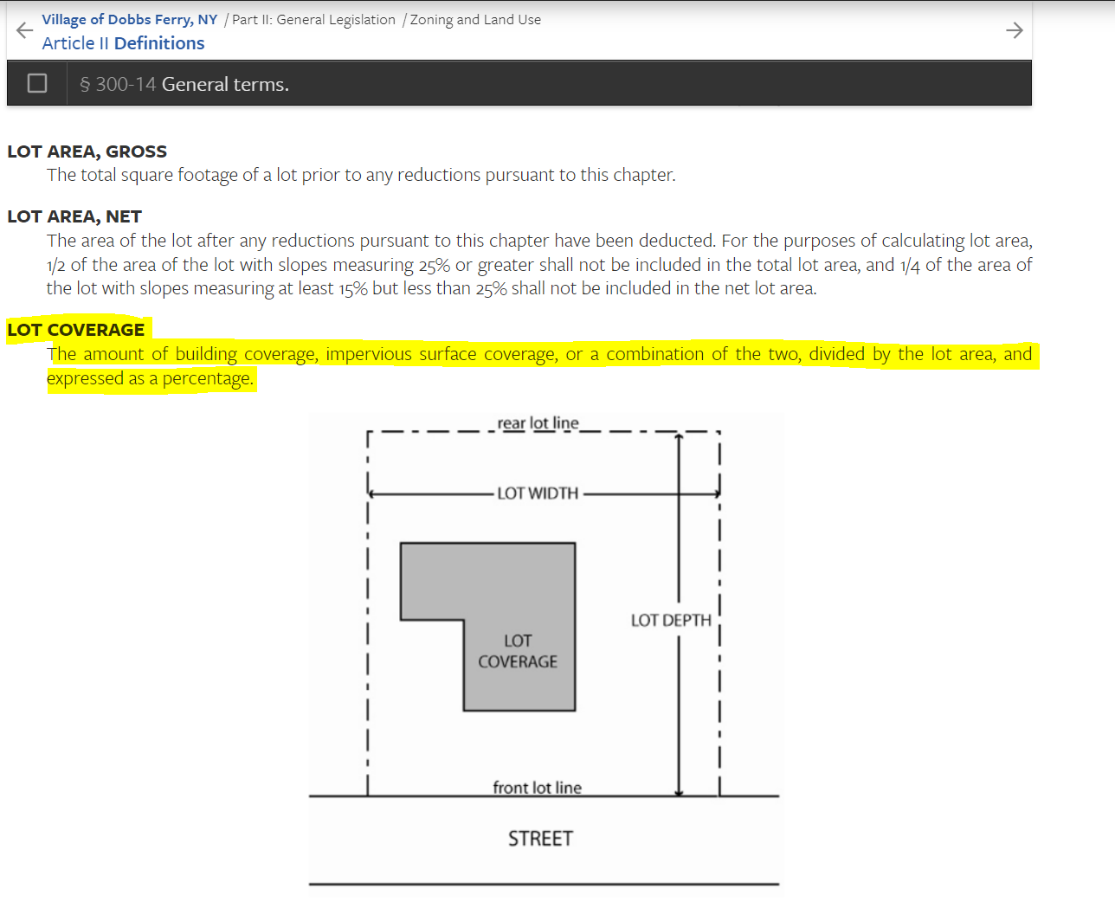
0 North Mountain Drive, Dobbs Ferry, New York
The term “Lot Coverage” as set forth within Table B-1 has its own definition
It is specifically defined as “The amount of building coverage, impervious surface coverage, or a combination of the two, divided by the lot area, and expressed as a percentage.”
Section 300-14 of the Village of Dobbs Ferry Code provides the definitions and general terms for what is referenced throughout Chapter 300 of the Code

Slide 5
0 North Mountain Drive, Dobbs Ferry, New York
Building Coverage is not defined in relation to Net Lot Area as what has been suggested by Nelson Pope Voorhis (“NPV”)
NPV’s statement as excerpted below is contrary to the plain language of the Code.
Section 300-14 of the Village of Dobbs Ferry Code provides the definitions and general terms for what is referenced throughout Chapter 300 of the Code
There is no basis or code reference for the requirement that the max lot coverage by buildings is linked in any way to Net Lot Area.
Lot Coverage is clearly defined in the Code, Building Coverage and Impervious Coverage are based upon the entire lot area, as the building coverage makes up a percentage of the impervious coverage.

Slide 6
0 North Mountain Drive, Dobbs Ferry, New York
As one can expect, Impervious area is also defined in the Code and is defined as follows:
Section 300-14 of the Village of Dobbs Ferry Code provides the definitions and general terms for what is referenced throughout Chapter 300 of the Code
As can be seen from the definition of Impervious Coverage, that calculation is an expression of the gross lot area.
It is unquestioned that lot coverage by buildings is part of the overall lot coverage by impervious surfaces and any interpretation other than the gross lot area is contrary to the plain language of the Code and contrary to the building department’s prior decisions on this issue.

Slide 7
0 North Mountain Drive, Dobbs Ferry, New York
10 Tiernan’s Lane, 41 Magnolia Drive, 7 Myrtle Avenue, 1 Myrtle Avenue, 289 Clinton, 19 McClelland Avenue, 1 and 3 King Street, 27 Virginia Avenue, Cyrus Place, 60Florence Avenue, 82 Belden Avenue, 31 Maple Street, 130 Palisade Street, 40 Devoe, 60 Washington Avenue
Section 300-14 of the Village of Dobbs Ferry Code provides the definitions and general terms for what is referenced throughout Chapter 300 of the Code

Slide 8
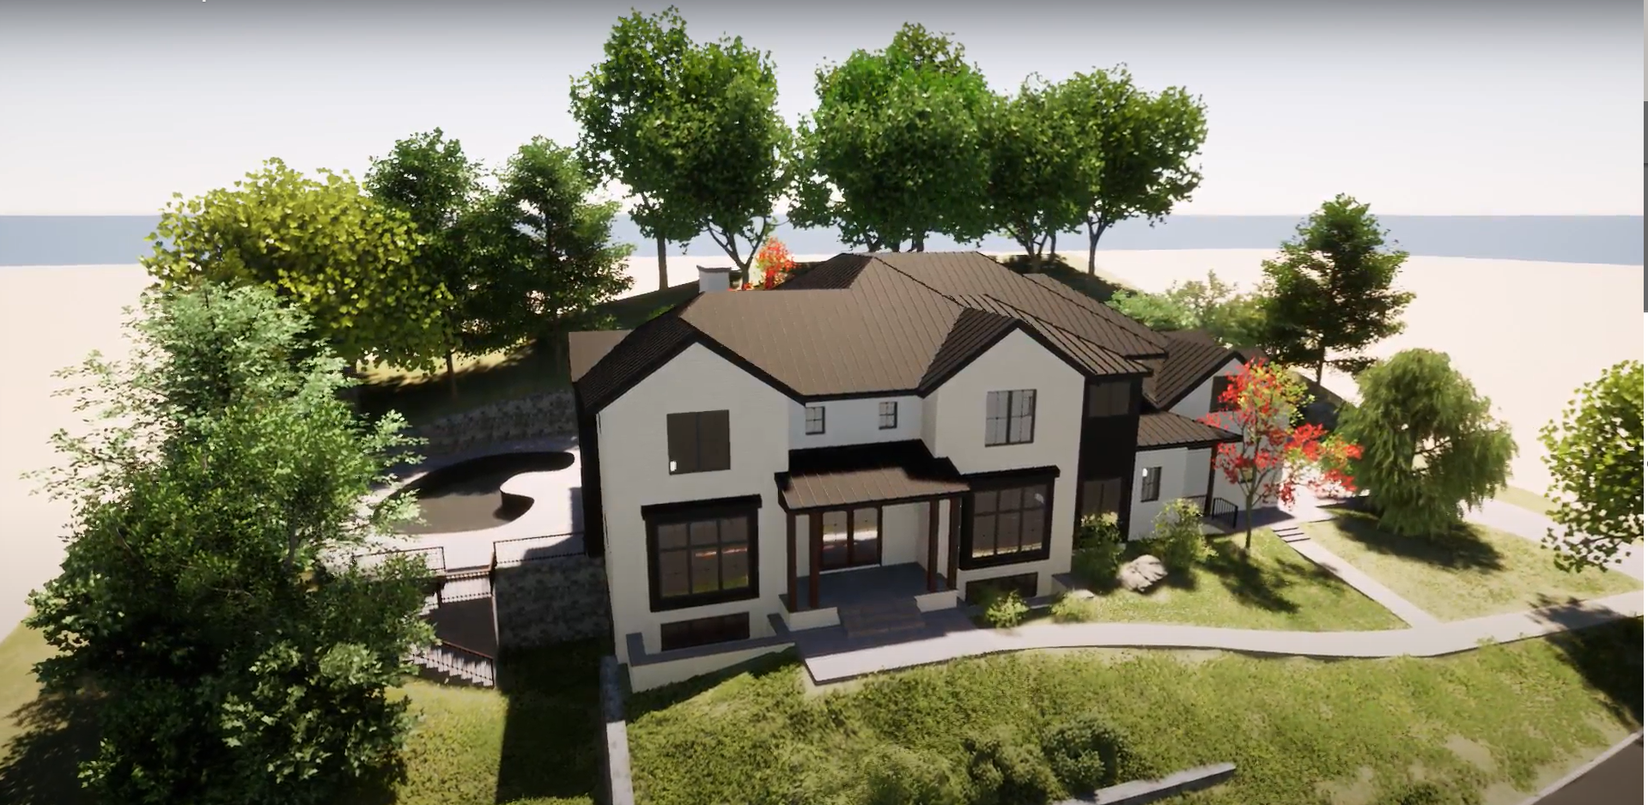
0 North Mountain Drive, Dobbs Ferry, New York
Rendering of proposed new single –family home
The Building Inspector/NPV’s position that maximum lot coverage, building coverage and impervious coverage are calculated in reference to net lot area is contrary to the plain language of the Dobbs Ferry Code, unprecedented and has not been substantiated by other references in the Village Code.

Slide 9
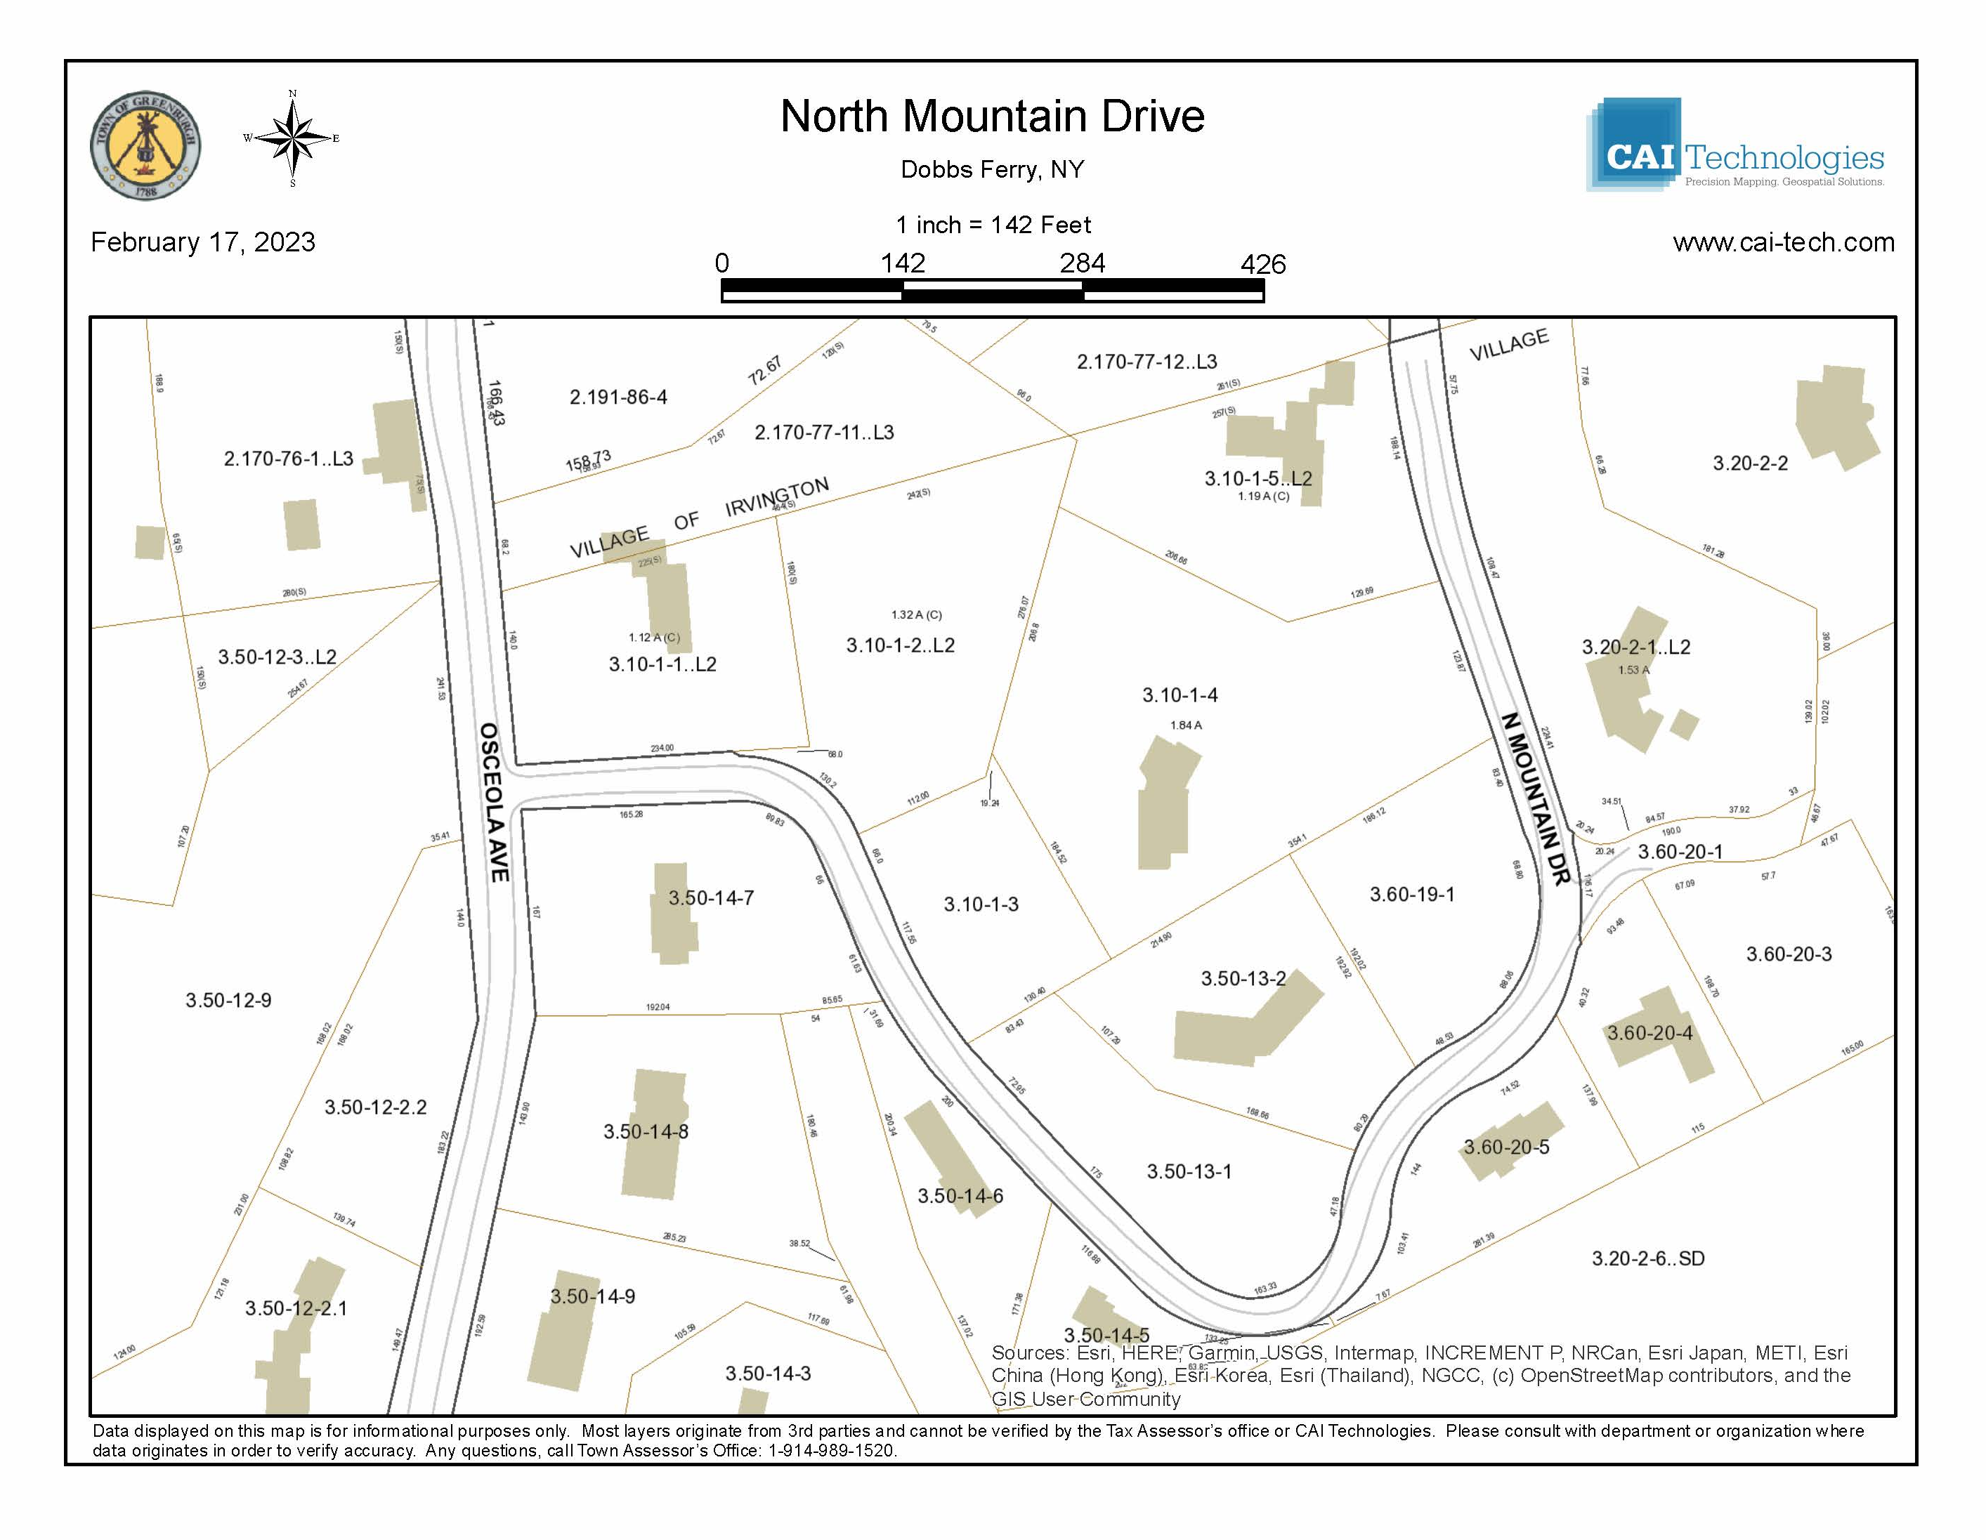

Slide 10
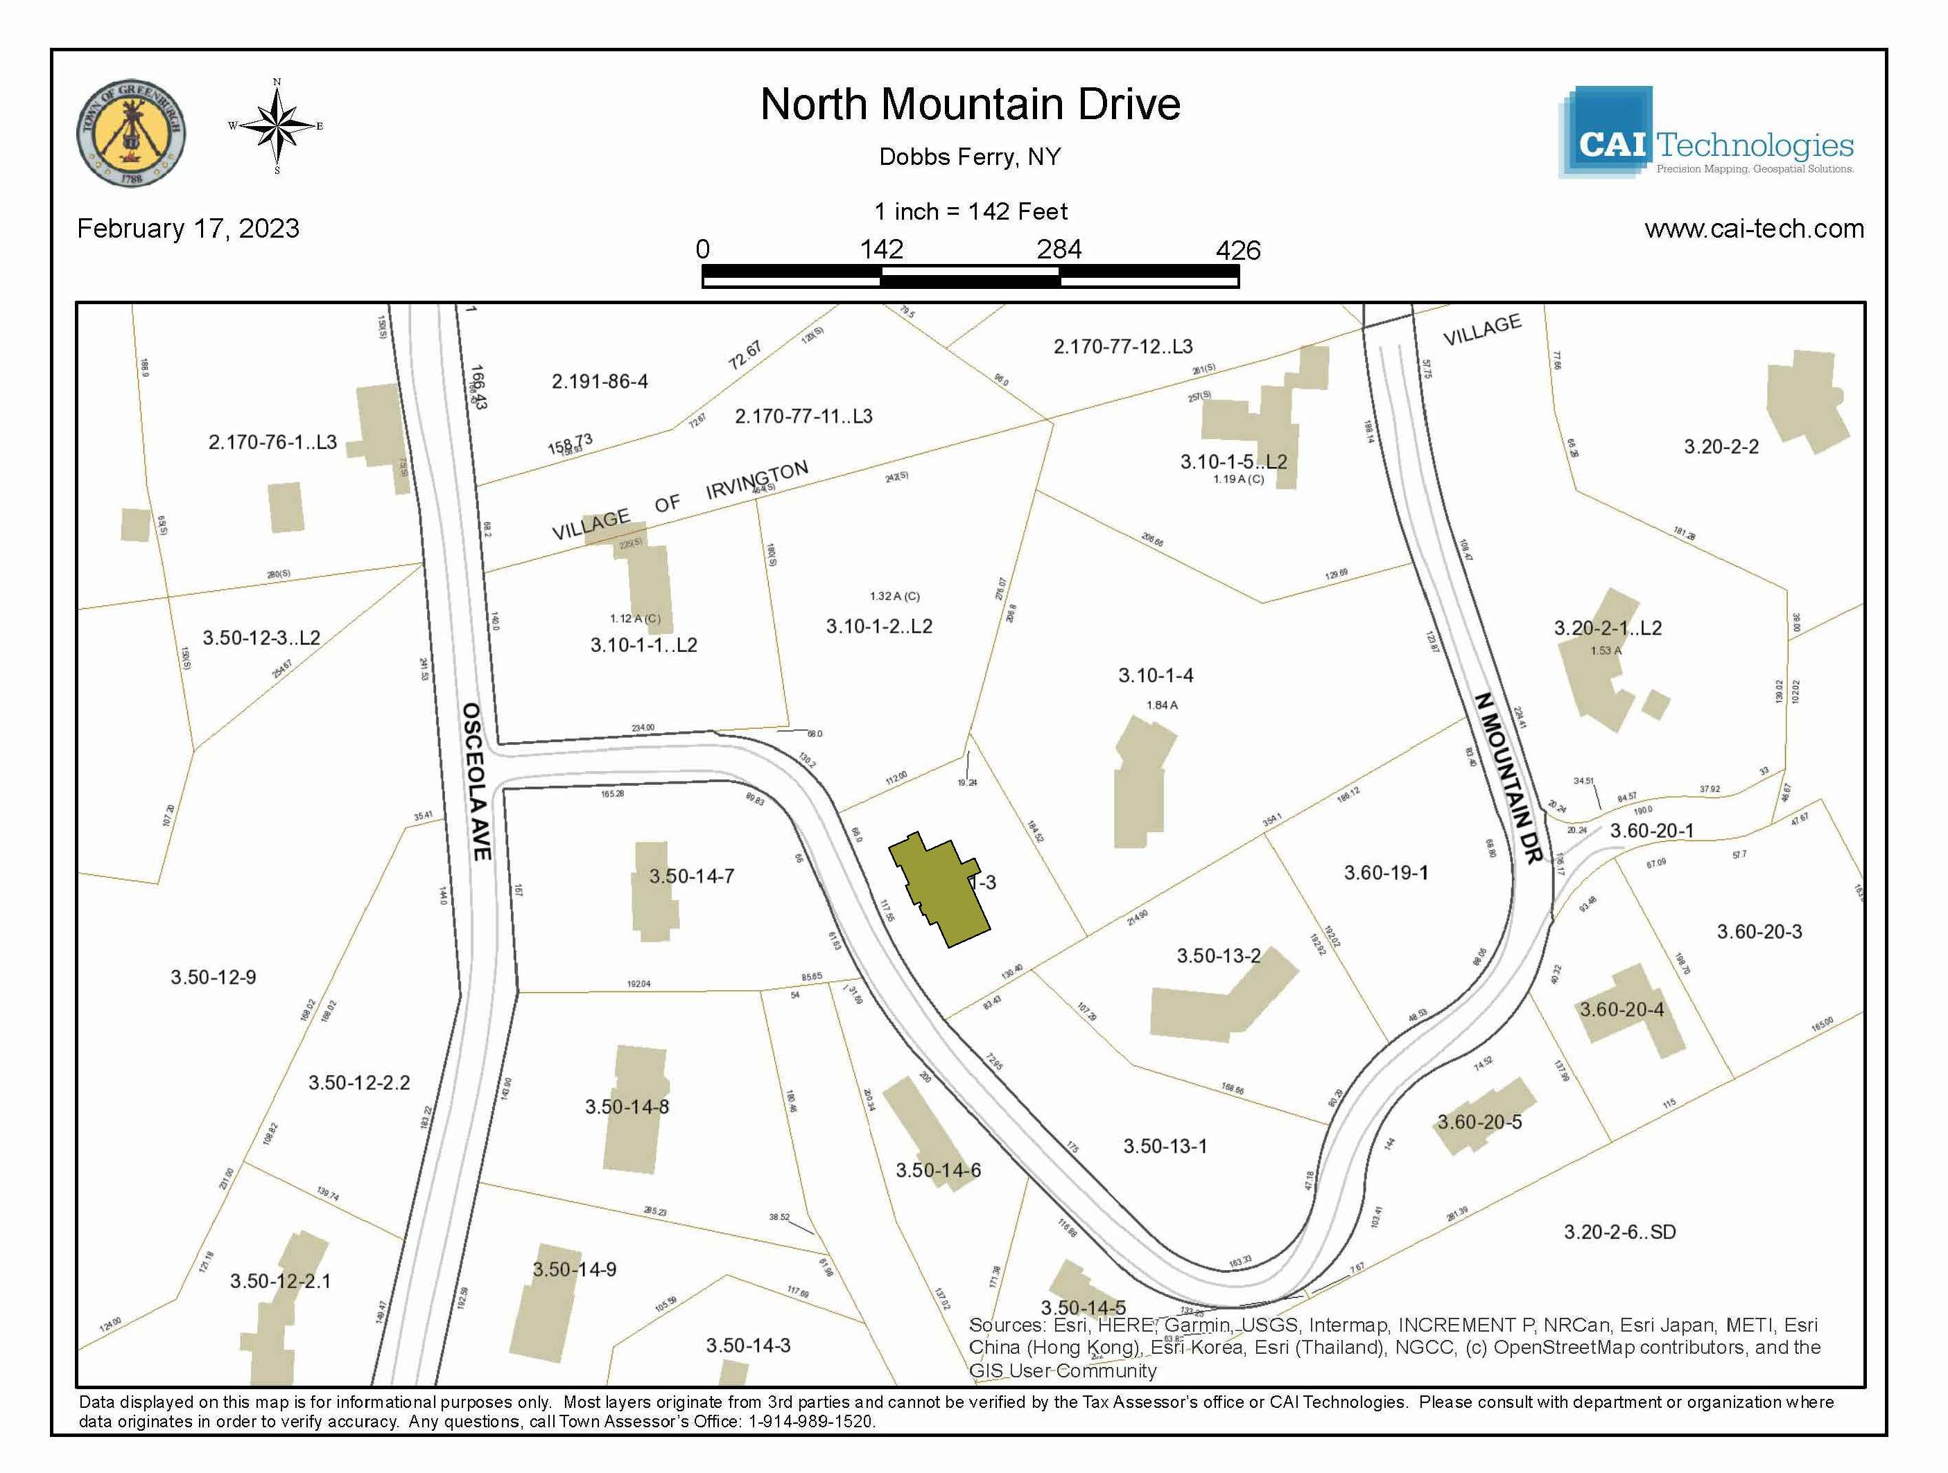

Slide 12
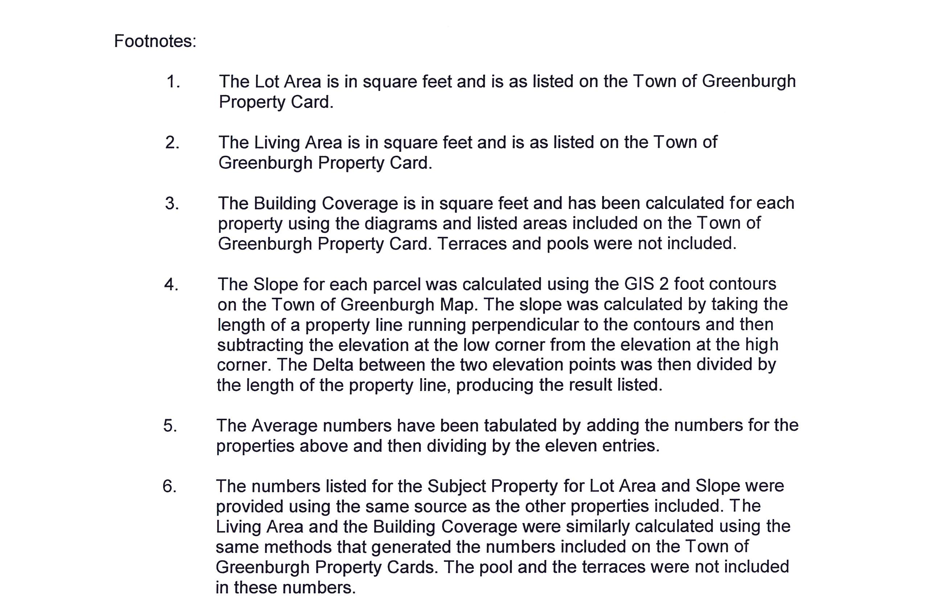

Slide 13
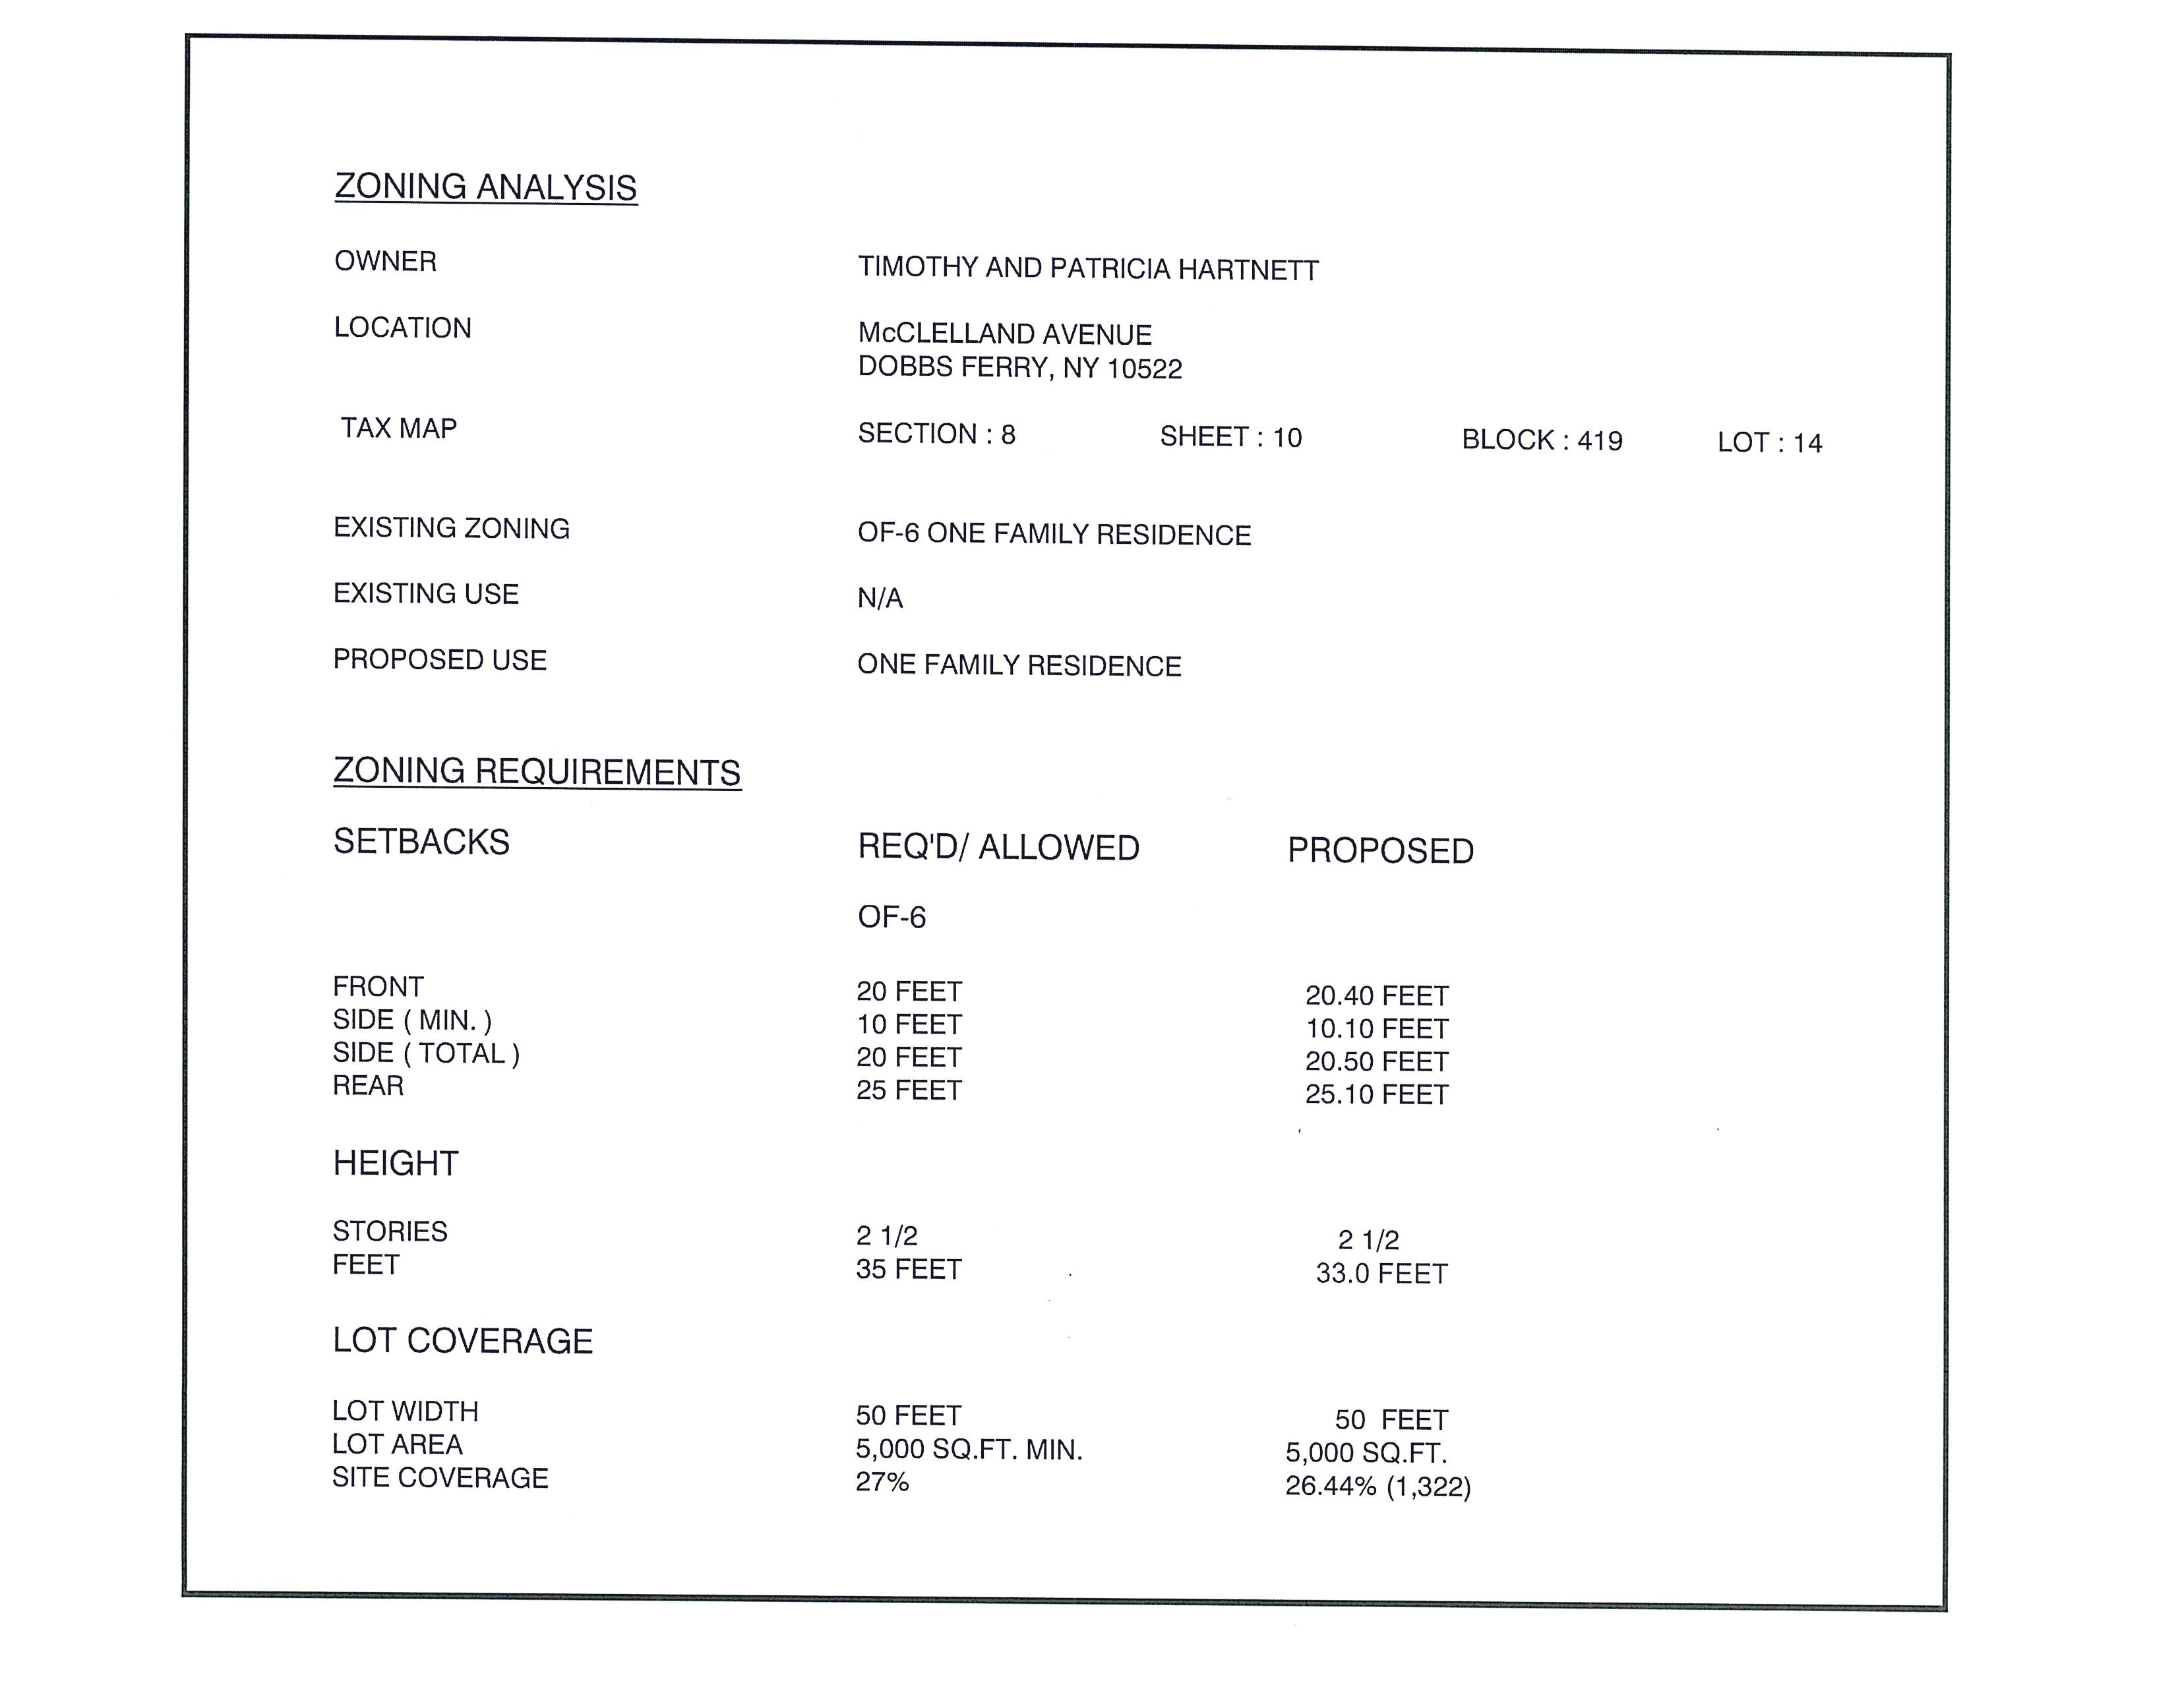

Slide 14
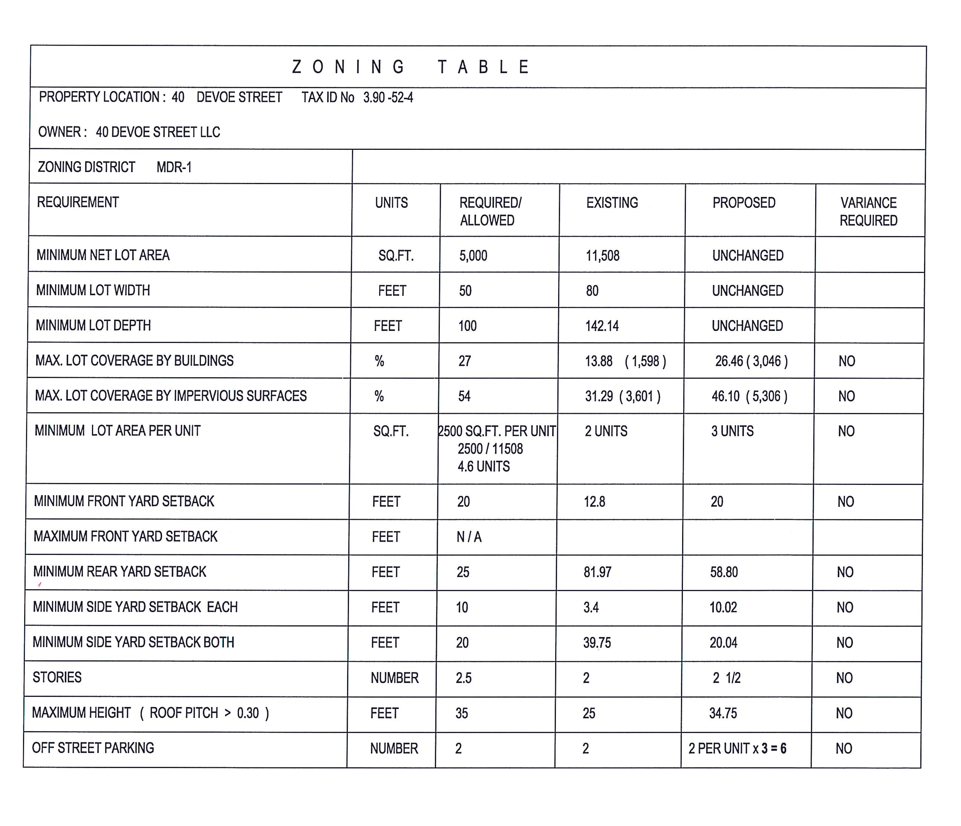

Slide 15
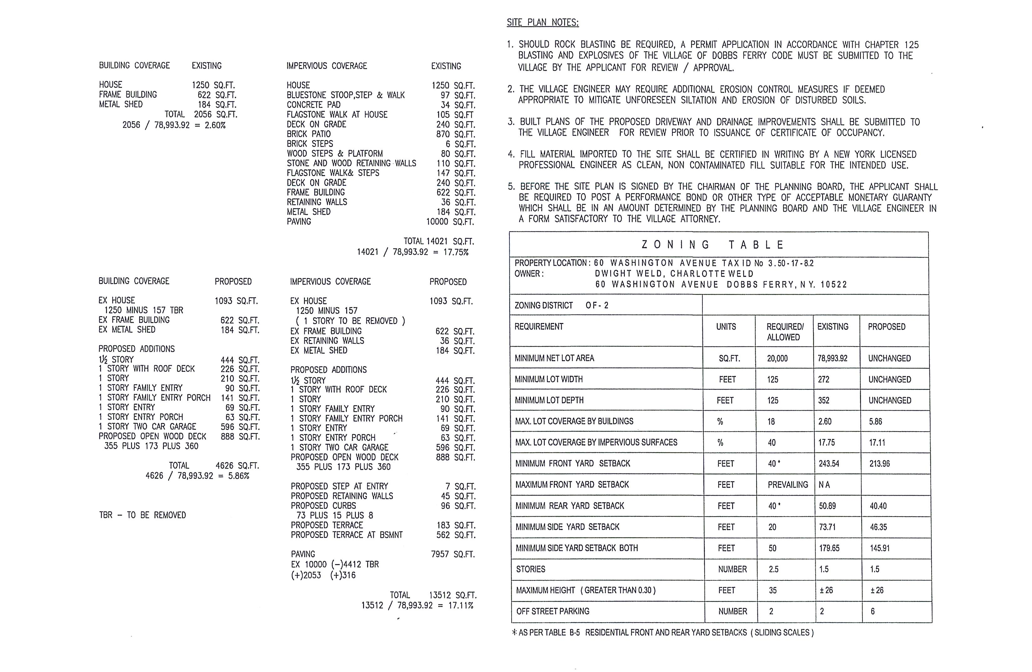

Slide 17
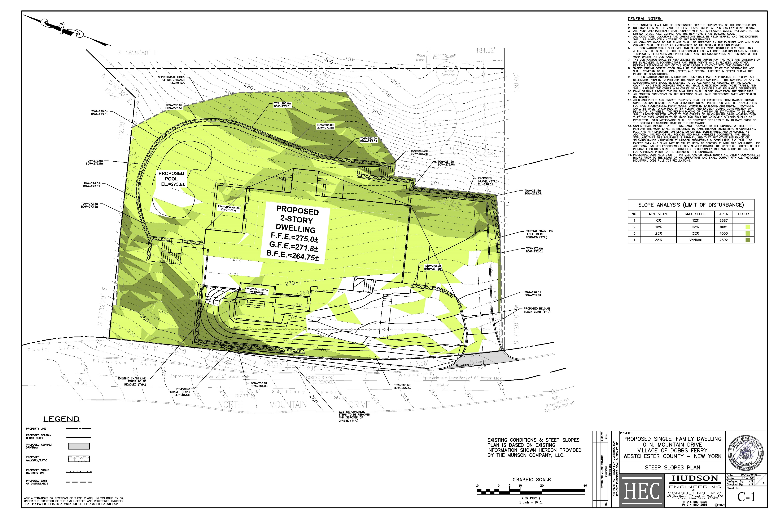

Slide 18
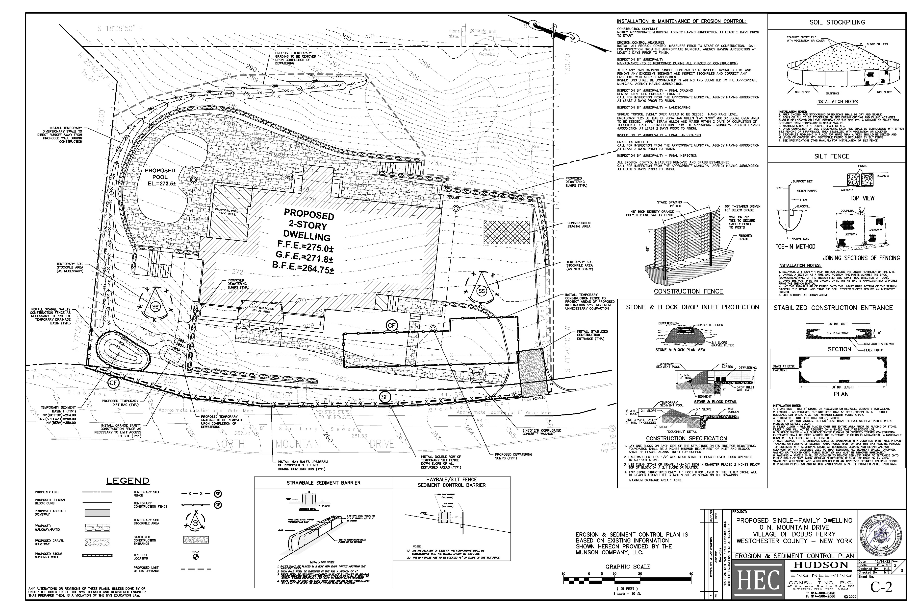

Slide 19
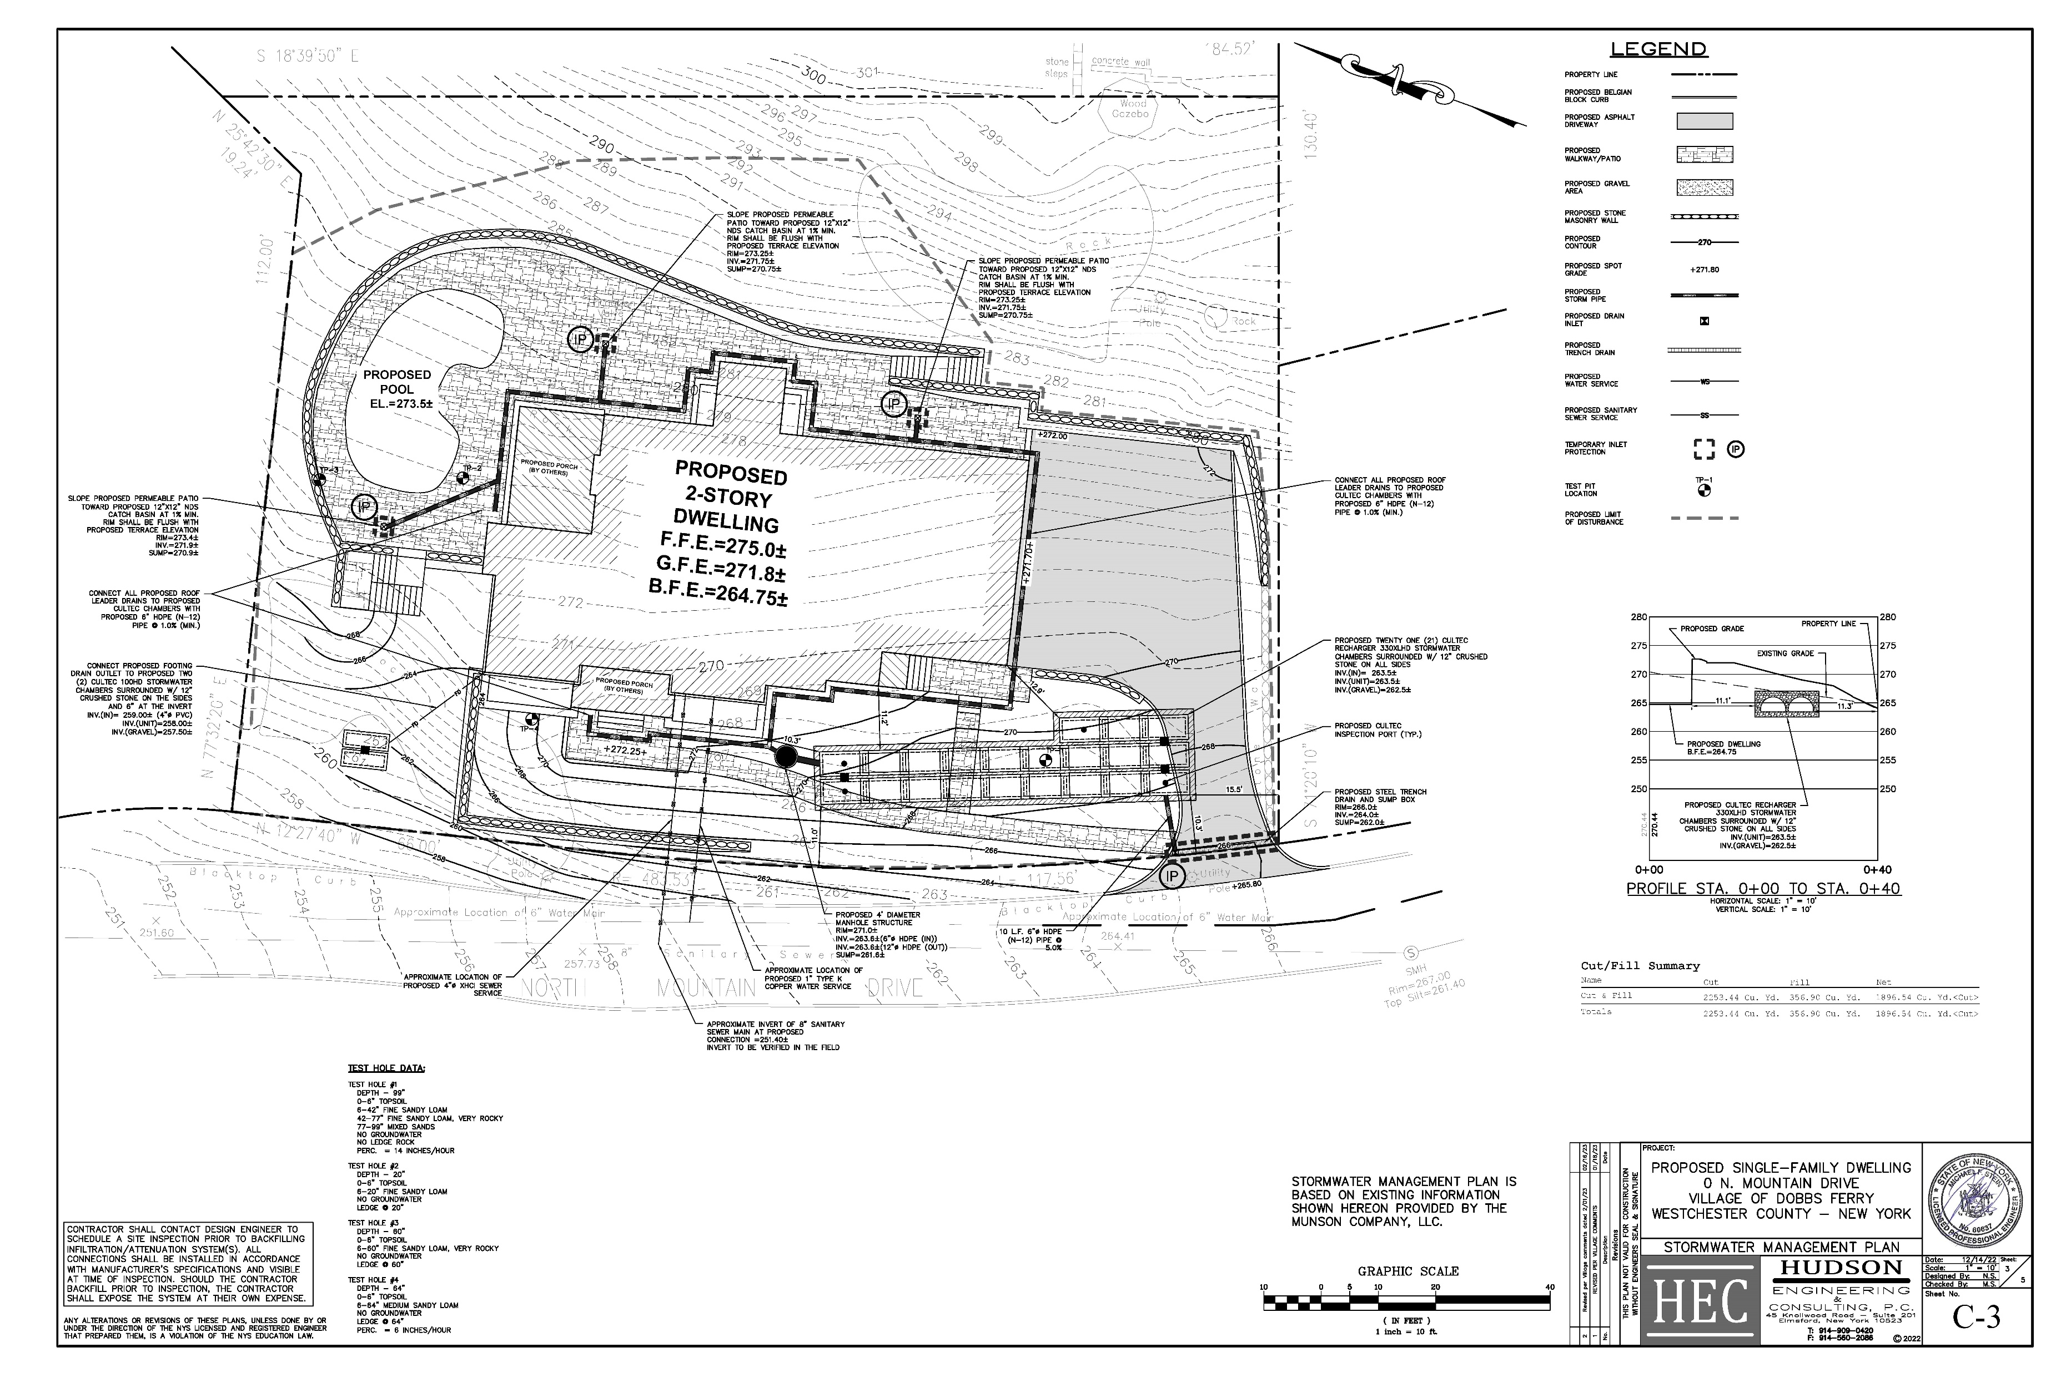

Slide 20
