Slide 1
COMMUNITY SURVEY Results
Presentation to the Board of Trustees
September 26, 2023

Slide 2
COMMUNITY SURVEY Objectives
:: Understand how community members who live, work, study, visit, and/or worship in Dobbs Ferry think and feel about diversity, equity, and inclusion in our village
:: Invite community members’ ideas and suggestions about how Dobbs Ferry can become an even more welcoming and affirming village
:: Gather information that will enable our committee to develop a strategic plan and identify opportunities to enhance our village’s diversity, equity, and inclusion
:: Share a summary of the survey findings with the Village BOT and the community at large

Slide 3
KEY Takeaways
116 surveys
Collected between
May 18 - July 4, 2023
A high level of satisfaction with the Mayor, Board of Trustees, and many of the Village Departments, especially the DF Public Library, as being supportive of human rights and diversity
A strong level of satisfaction with the variety of activities and events representing/supporting DEI, and a desire to have more such events
A significant level of interest in in having further discussions and focus groups centered on human rights and diversity in Dobbs Ferry
A variety of opportunities to improve and enhance Dobbs Ferry as a welcoming and affirming community

Slide 4
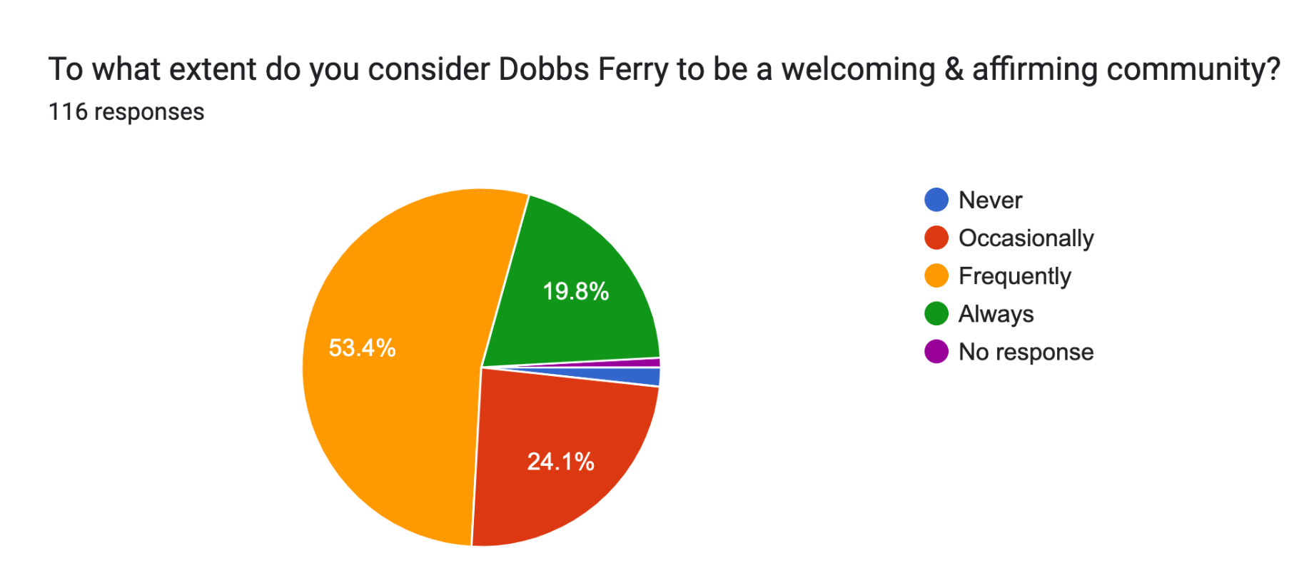
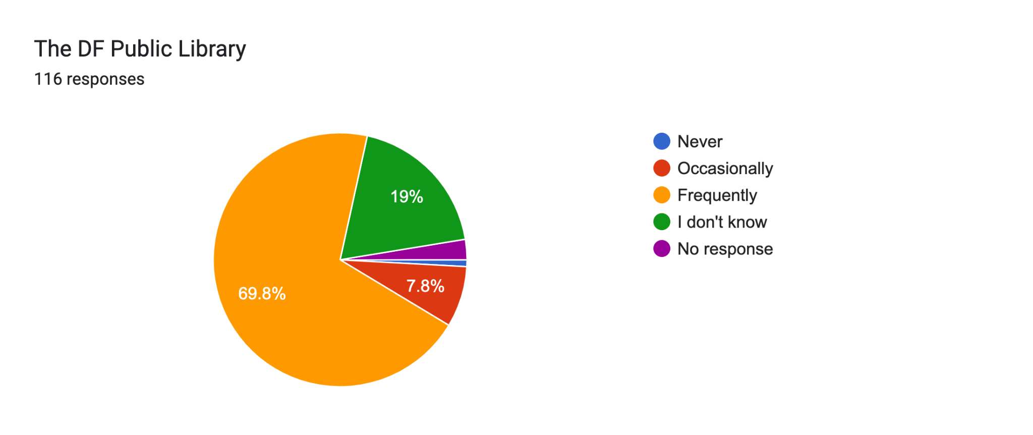
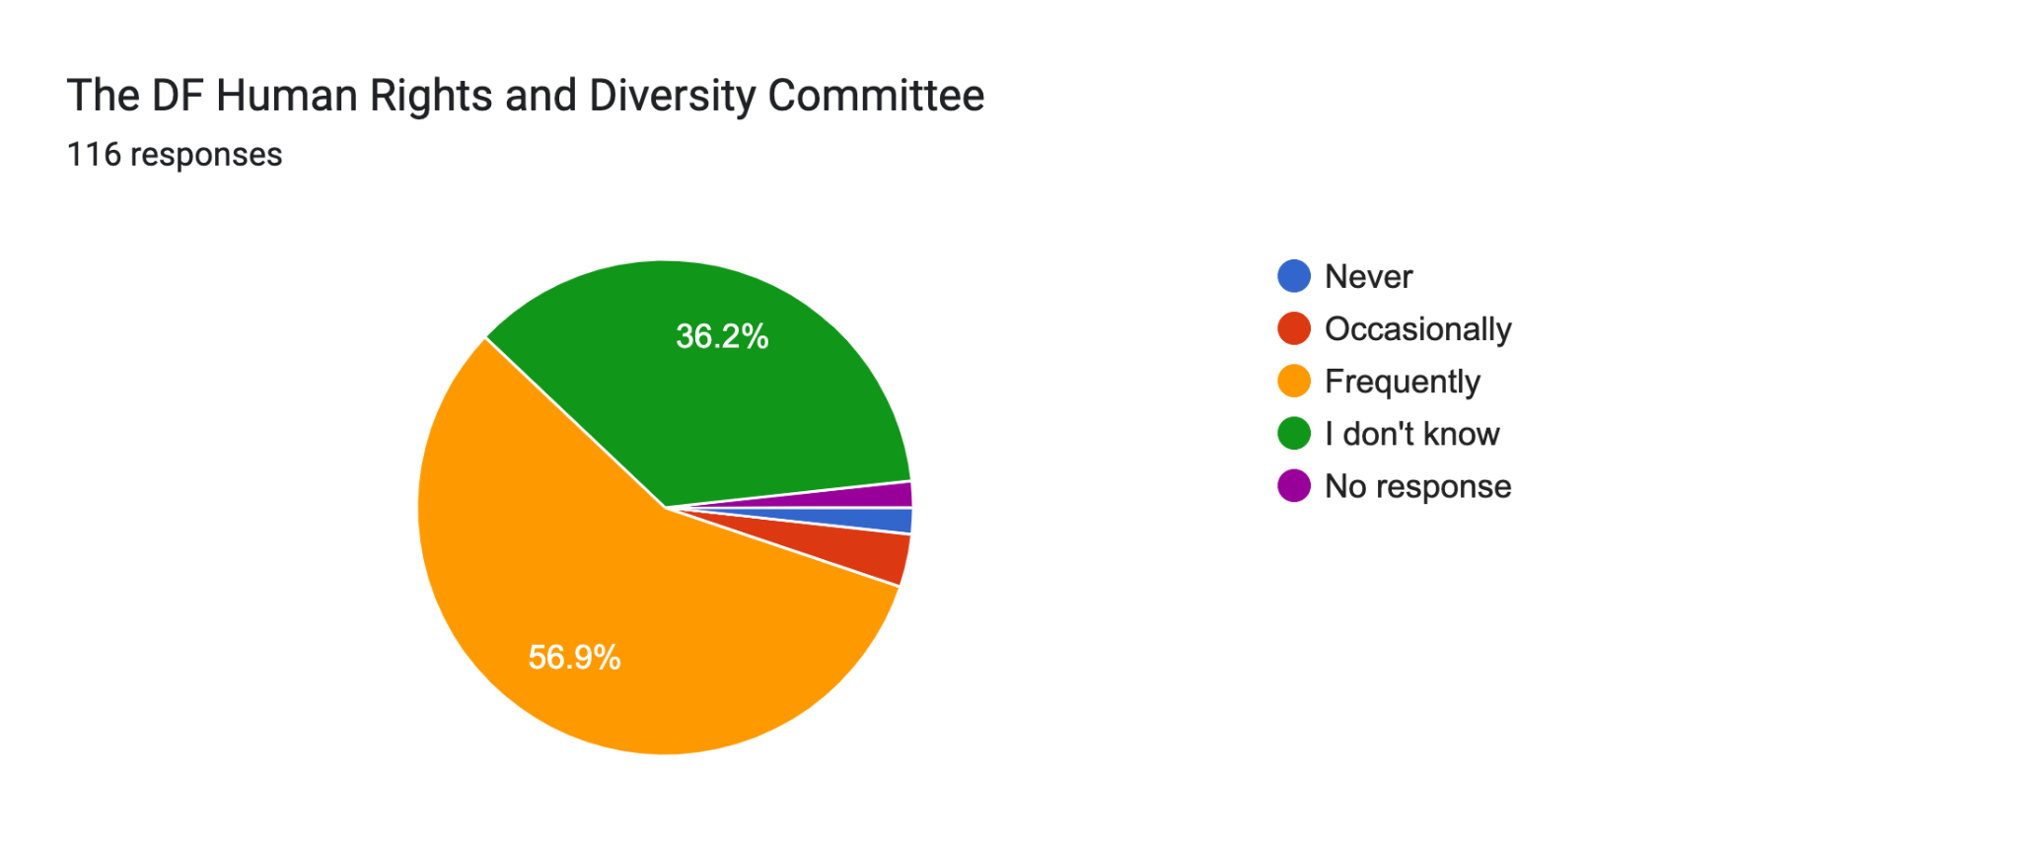
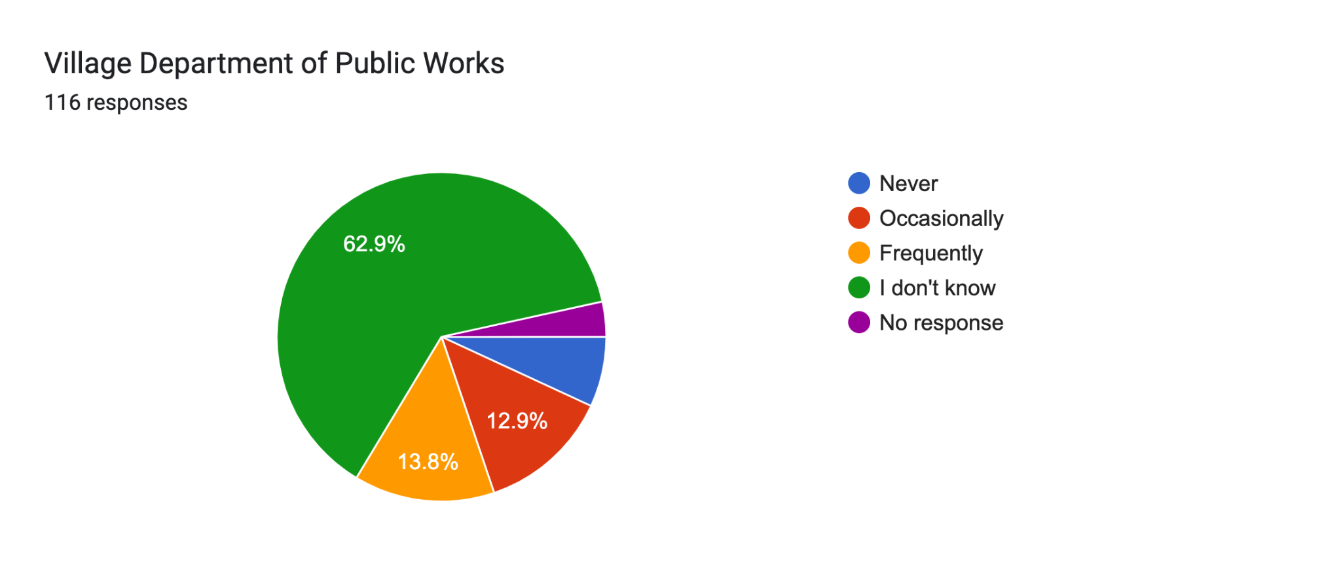
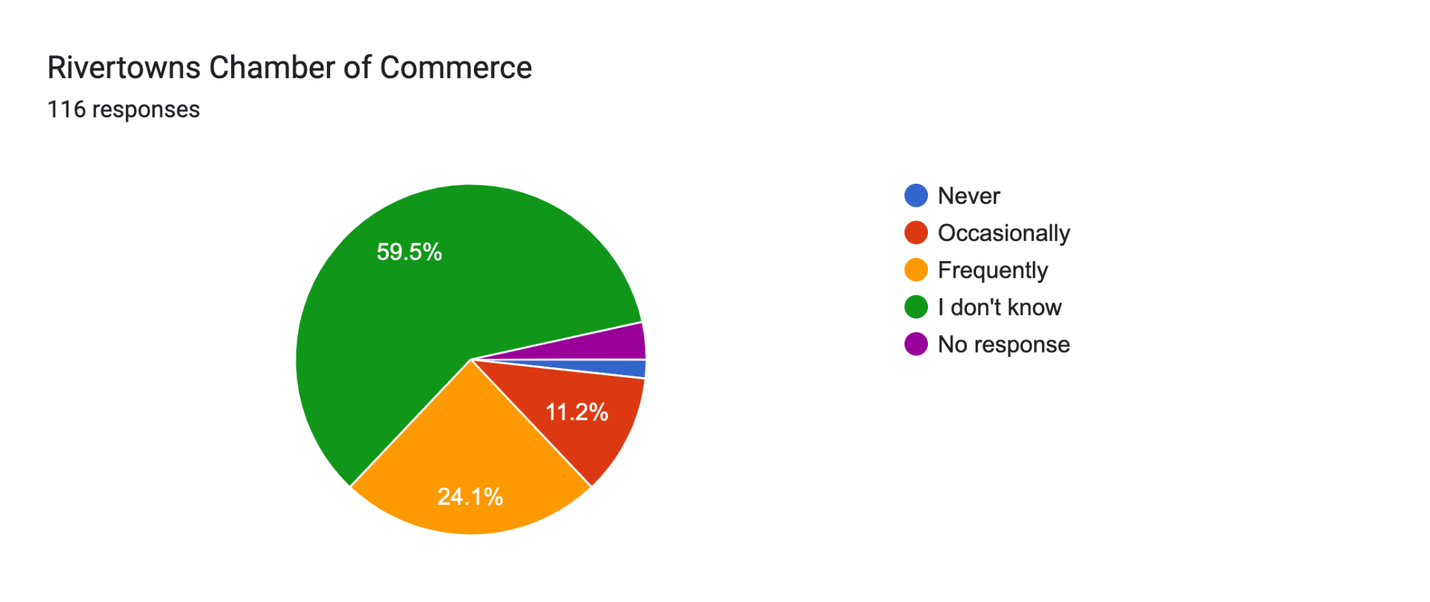
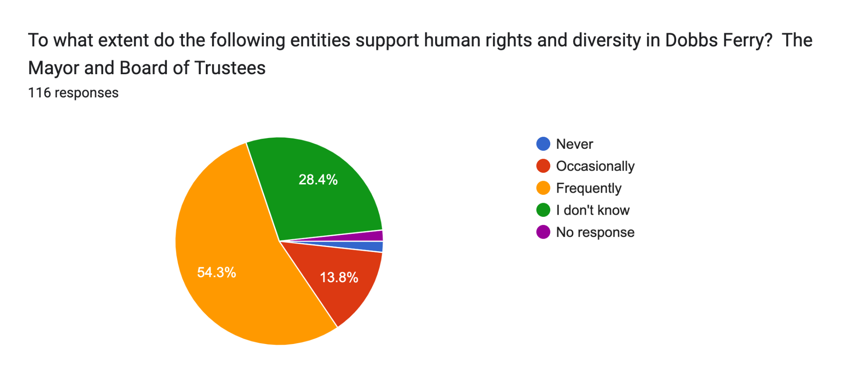
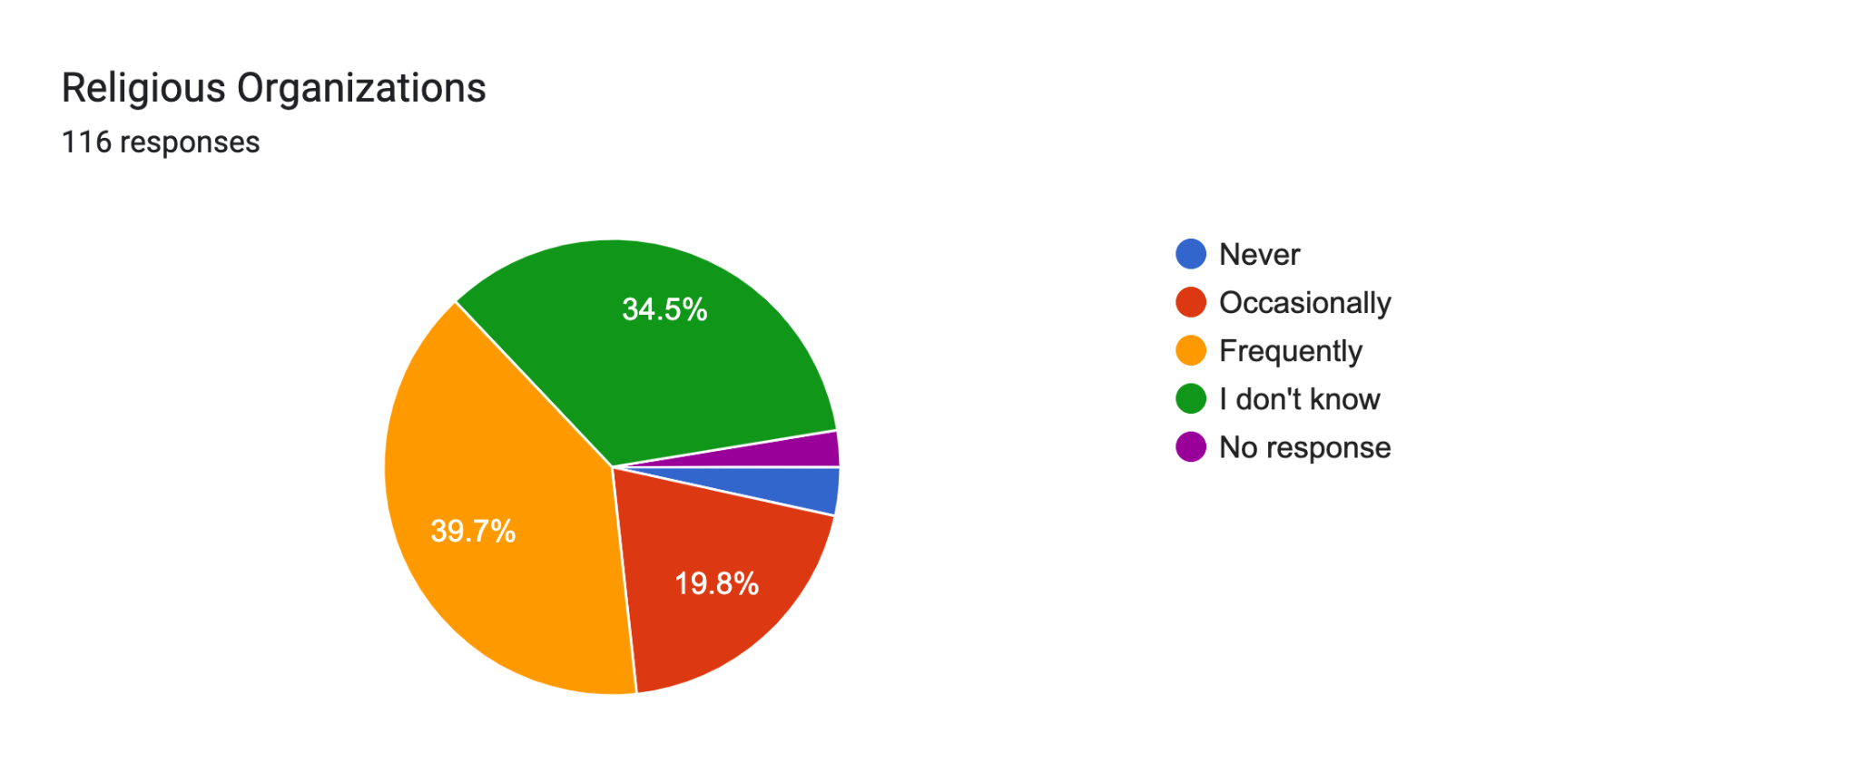
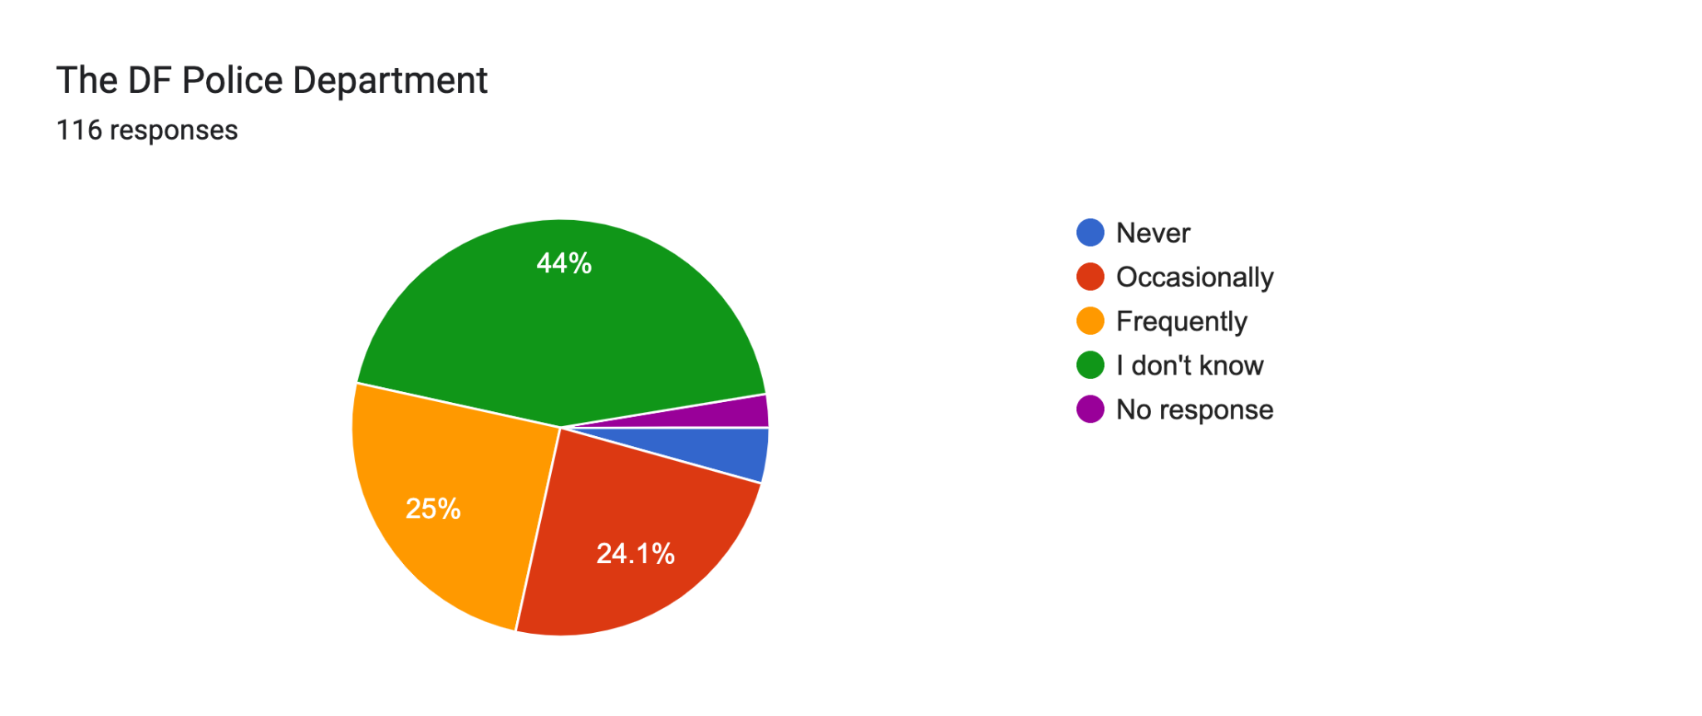
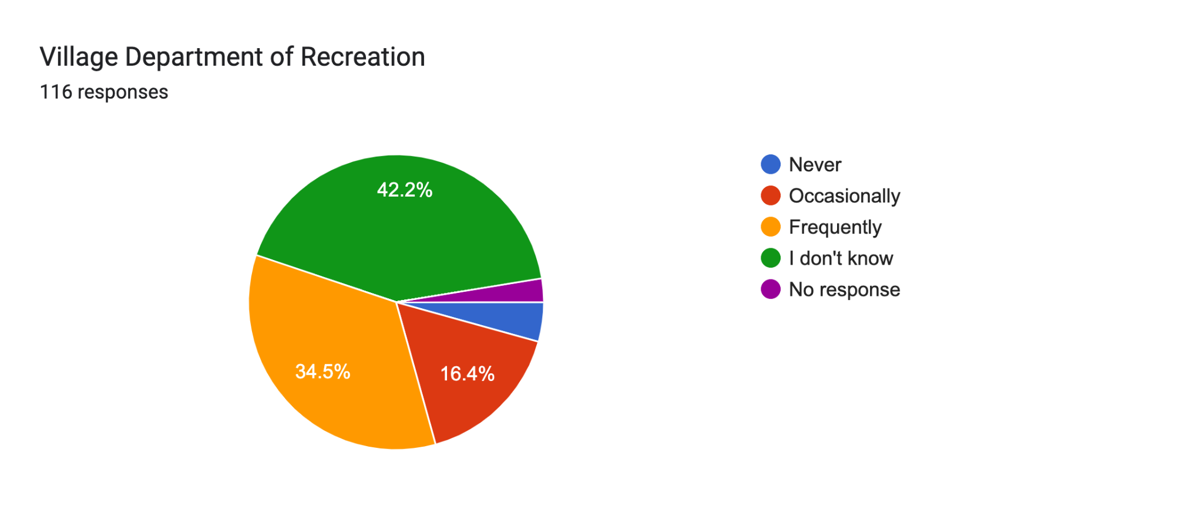
DEPARTMENTS

Slide 5
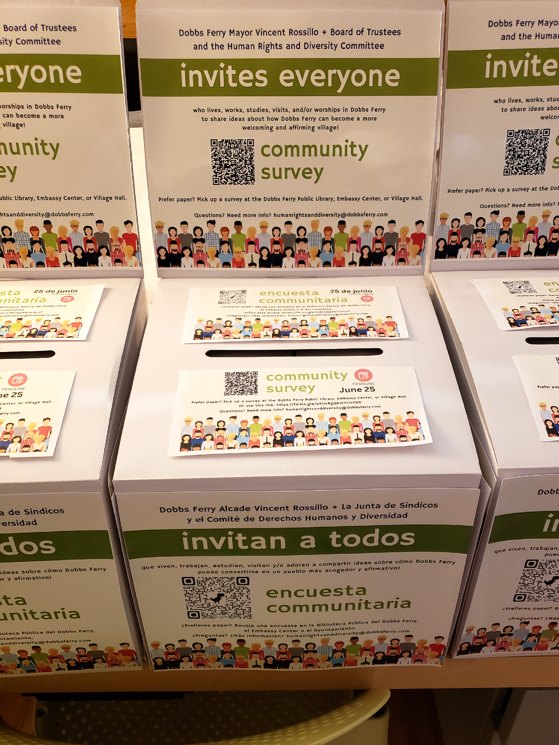
“A survey like this makes some of us feel like we are seen and we matter to this community.”

Slide 6
SURVEY PARTICIPANTS Demographics
Dobbs Ferry Survey Participants (n=116) | July 2022 Census.gov Population Estimates (N=11,337)
53% Female/Women 25% Male/Men | 49.2% Female/Women
43.1% ages 40-60 25.9% >60 years old | 17% 65 years old +
17.4% White 7% Asian 3.48% Hispanic/Latine 2.32% Black/African American 16.24% Two or more races | 69.5% White alone, not Hispanic/Latino 9.6% Asian alone 12.7% Hispanic/Latino 3.9% Black/African American alone 5.8% Two or more races
31% Undergraduate degrees 48.3% Graduate degrees | 61.7% Bachelor’s degree or higher

Slide 7
Themes
From
Written Comments
The majority of written comments regarding experiencing the Village as “welcoming and affirming” lean toward not welcoming and/or ambivalence
Some village entities have a high percentage of “I don’t know” responses to the question: “To what extent do the following entities support human rights and diversity in Dobbs Ferry?”
The majority of feedback about Village-wide LGBTQ+ efforts was positive
Concern about “One Dobbs” Facebook page
A significant subset of respondents do not perceive the Village and DFSD as separate entities

Slide 8
SUGGESTED Next Steps
Share a summary of the survey findings
Conduct Focus Groups
Conduct interviews/discussions with community and business leaders
Collaborate with village departments to communicate and amplify activities that showcase Dobbs Ferry as a welcoming and affirming community
Develop initiatives to further enhance Dobbs Ferry as a welcoming and affirming place to live

